Slide 1
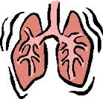
F211 Exchange and Transport Lungs
What do animals need to gain from their environment to stay alive? How do these substances get to cells?
What do plants need to gain from their environment to stay alive? How do these substances get to cells?
Give 2 examples of wastes that living organisms have to get rid of somehow. How does the waste get from the cells to where it is excreted?

Slide 2
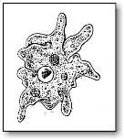
Learning Outcome
You should be able to:
Explain, in terms of surface-area-to-volume ratio, why multicellular organisms need specialised exchange surfaces and single-celled organisms do not.

Slide 3
Increasing size and complexity
Single celled organisms do not need complex exchange and transport systems.
Why not?
How does exchange of substances take place? How do they transport substances into the centre?
Bigger organisms with several or many layers of cells and which are more active need specialised exchange and transport systems, why?

Slide 4
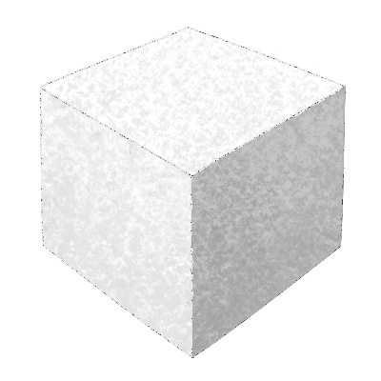
Complete the table to show how surface area to volume ratio changes as size of cube increases
Length of side (cm) | Area of side (cm²) | Total area (cm²) | Volume (cm³) | SA/Volume ratio
1 | 1 | 6 | 1 | 6/1= 6:1
2
5
10
20

Slide 5
Completed table to show how surface area to volume ratio changes as size of cube increases
Length of side (cm) | Area of side (cm²) | Total area (cm²) | Volume (cm³) | SA/Volume ratio
1 | 1 | 6 | 1 | 6/1= 6:1
2 | 4 | 24 | 8 | 24/8= 3:1
5 | 25 | 150 | 125 | 150/125= 1.2 :1
10 | 100 | 600 | 1000 | 600/1000= 0.6 :1
20 | 400 | 2400 | 8000 | 2400/8000 = 0.3 :1
The bigger the object the less outer surface it has compared to its volume. This means it is harder for substances to move into the object and through to the centre of the object by diffusion.

Slide 6
Features of Exchange Surfaces?
Large surface area, often folded
Thin barrier to reduce diffusion distance
Fresh supply of required molecules on one side to keep concentration high
Removal of required molecules on other side to keep concentration low
(maintains concentration gradient)

Slide 7
Examples of exchange/ absorption surfaces
Alveoli, exchange of oxygen and carbon dioxide
Small intestine, absorption of nutrients
Liver cells (hepatocytes), absorption of metabolically active substances, blood sugar levels adjusted
Root hairs, water and minerals absorbed
Fungal hyphae, absorption of nutrients

Slide 8
Learning Outcomes You should be able to:
Describe the features of an efficient exchange surface with reference to diffusion of oxygen and carbon dioxide across an alveolus.
Describe the features of the mammalian lung that adapt it to efficient gas exchange.

Slide 9
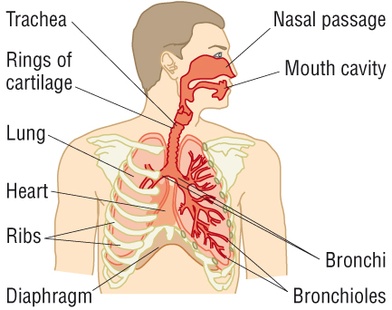
The Lungs and Associated Structures
(familiar from KS3 and KS4)

Slide 10
The Lungs and Associated Structures
(familiar from KS3 and KS4)

Slide 11
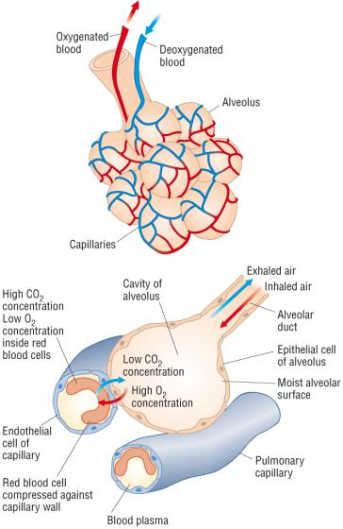
Features of the mammalian lung that enable efficient gas exchange
Individual alveoli are only100-300 micrometers across, very numerous ( about 300-500 million) total surface area = approx 70 m²
Alveoli walls are one cell thick, plasma membranes surround a very thin layer of cytoplasm.
Capillary wall is only one cell thick
Cells are squamous, flattened
Capillaries in close contact with alveolus wall
Capillaries very narrow so RBCs are squeezed close to the walls and so close to the air in the alveoli
Total diffusion distance from inside alveolus to inside RBC is only about 1 micrometer
Surfactant stops alveoli collapsing due to cohesion of water when air pressure is low
Ventilation and blood transport maintains concentration gradients of oxygen and carbon dioxide for efficient gas exchange

Slide 12
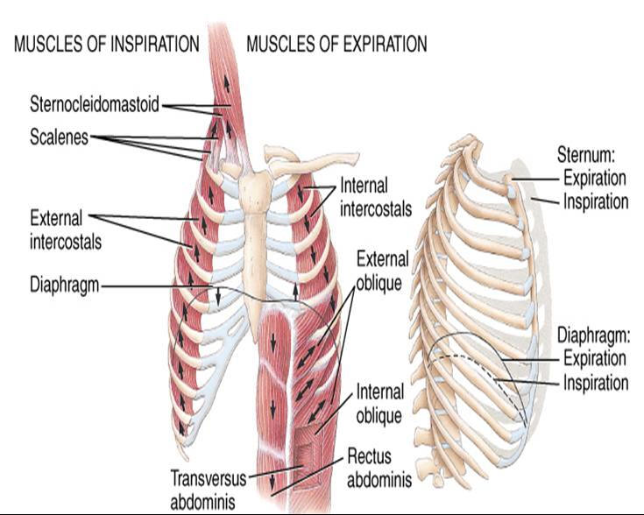
Muscles involved in ventilation

Slide 13
Outline the mechanism of breathing (inspiration and expiration) in mammals, with reference to the function of the rib cage, intercostal muscles and diaphragm.
INHALING | EXHALING
Diaphragm ………….. to become …………… and pushes digestive organs ……………… | Diaphragm …………….. and is pushed …… by displaced organs underneath
External intercostal muscles ………. to ……………. ribs | External intercostal muscles …………. and ribs ……………….
Volume of chest cavity ………………. | Volume of chest cavity ……………….
Pressure in chest cavity …………. ……………… atmospheric pressure | Pressure in lungs ……………. and rises ………….. atmospheric pressure
Air moves …………. lungs | Air moves …………. lungs
Remember to relate air movements to changes in volume of chest cavity and hence changes in air pressure.

Slide 14
Describe the distribution of cartilage, ciliated epithelium, goblet cells, smooth muscle and elastic fibres in the trachea, bronchi, bronchioles and alveoli of the mammalian gaseous exchange system.
 | cartilage | Ciliated epithelium | Goblet cells | Smooth muscle | Elastic fibres
Trachea | Y | Y | Y | Y | Y
Bronchi | Y | Y | Y | Y | Y
Bronchioles | N | Y | N | Y | Y
Alveoli | N | N | N | N | Y
What is the role of each of these tissues? (What is the definition of a tissue?)
Make notes in the table supplied using pages 48 and 49 of your text book
NB the role of surfactant (not a tissue) on the internal surfaces of the alveoli

Slide 15
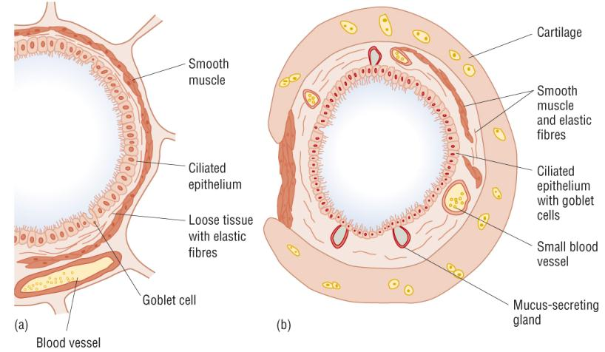
Bronchiole and Trachea in transverse section
Later in Unit 1 Module 1 with MSM you will be discussing the organisation
of cells and tissues into organs. The trachea is a useful example to use.
Several different types of tissues made of specialised cells work together to form a functional unit whose purpose is to deliver air to and remove air from the gas exchange surface of the alveoli

Slide 16
cartilage
Smooth muscle
And elastic fibres
Ciliated epithelium
and goblet cells

Slide 18
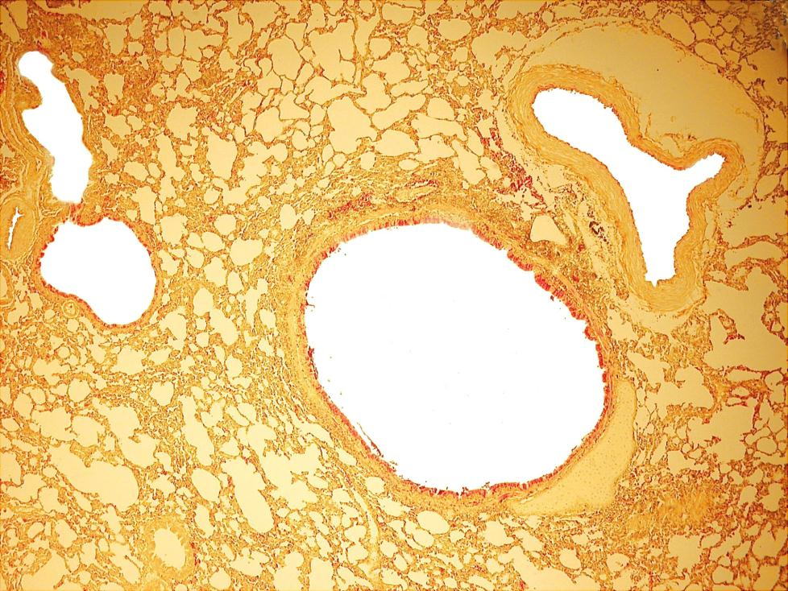

Slide 20
Measuring lung capacity
LEARNING OUTCOME :
Be able to explain the meanings of the terms tidal volume and vital capacity.
TIDAL VOLUME : volume of air moved in and out of the lungs with each breath at rest. (Approx 0.5 dm³) Provides sufficient oxygen for body’s resting needs and removes sufficient carbon dioxide to keep levels safe.
VITAL CAPACITY: The largest volume of air that can be moved in or out of the lungs in one breath. (Approx 5 dm³) varies with gender, size, age, exercise level, etc
© Pearson Education Ltd 2008
This document may have been altered from the original

Slide 21
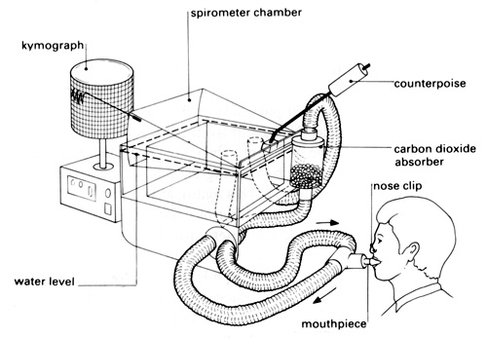
Describe how a spirometer can be used to measure vital capacity, tidal volume, breathing rate and oxygen uptake.
Chamber filled with oxygen floats on water
Wear nose clip to ensure gas exhaled goes back into tank not to atmosphere
Breath in, chamber goes down
Breath out chamber goes up
Movements of chamber recorded on kymograph or datalogger
Soda lime absorbs CO₂ produced and exhaled
Total volume in tank decreases over time as O₂ used up and CO₂ absorbed, so trace falls over time.

Slide 22
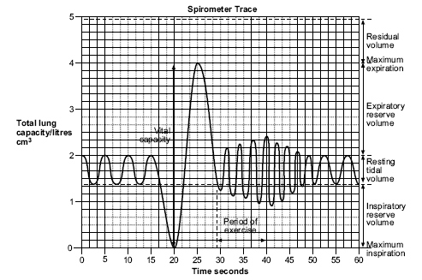
Analyse and interpret data from a spirometer.

Slide 23
LO: explain the need for transport systems in multicellular animals in terms of size, activity and surface area to volume ratio
All cells need energy, where do they get it from?
How is the energy released?
How do the food molecules and oxygen get to the cells in simple organisms and complex organisms?
How does the organism’s activity level influence how fast the food molecules and oxygen have to get to the cells?
Does the fact that some organisms are ectothermic (cold blooded) and some are endo thermic (warm blooded) affect how fast these molecules need to be supplied to cells?

Slide 24
What are the features of an efficient oxygen and nutrient molecule transport system?
A fluid medium to carry molecules
A pump to push the fluid round
Exchange surfaces for oxygen and nutrients to enter and leave the blood
Vessels to carry the fluid medium round the organism
Separate circuits to pick up oxygen from the environment and deliver it to the cells.

Slide 25
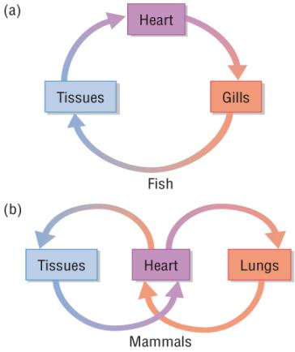
Explain the meaning of the terms single and double circulation with reference to the systems of fish and mammals
What are the disadvantages of this system?
Heart cannot pump at high pressure
Reduced blood pressure in capillaries of gills to reduce chance of damage
Slow rate of flow in rest of body
Limited rate of delivery of oxygen and glucose to tissues
Fish have a single circulation system. Blood flows from the heart to the gills and then on to the body before returning to the heart

Slide 26
Explain the meaning of the terms single and double circulation with reference to the systems of fish and mammals
What are the advantages of the mammalian system?
Heart can increase blood pressure after blood passes through lungs
Increased speed of delivery
Increased blood pressure in systemic system, oxygen and glucose get to tissues quickly
Lower blood pressure in pulmonary system decreases the chance of damaging capillaries in the lungs
Mammals have double circulatory systems. One circuit (pulmonary) takes blood from the heart to the lungs and back, the other(systemic) takes blood from heart to body tissues and back.

Slide 27
Explain the meaning of the terms single and double circulation with reference to the systems of fish and mammals
To see how the heart and circulatory systems have evolved go to:
http://mhhe.com/biosci/genbio/biolink/j_explorations/jhbch05.htm

Slide 28
Learning outcomes
Describe the external and internal structure of the mammalian heart.
Explain the differences in thickness of the walls of the different chambers of the heart in terms of their functions.

Slide 29
Heart diagrams
Label as much as you can on the diagram using the labels on the sheet supplied.

Slide 30
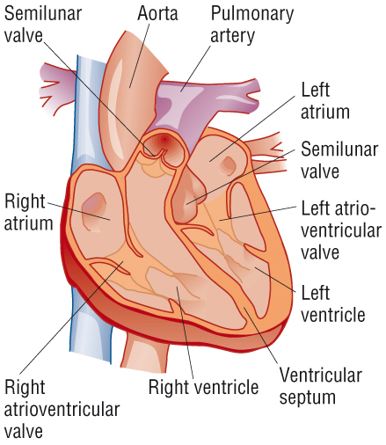

Slide 31
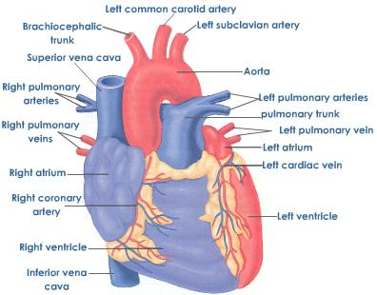
External view of Heart

Slide 32
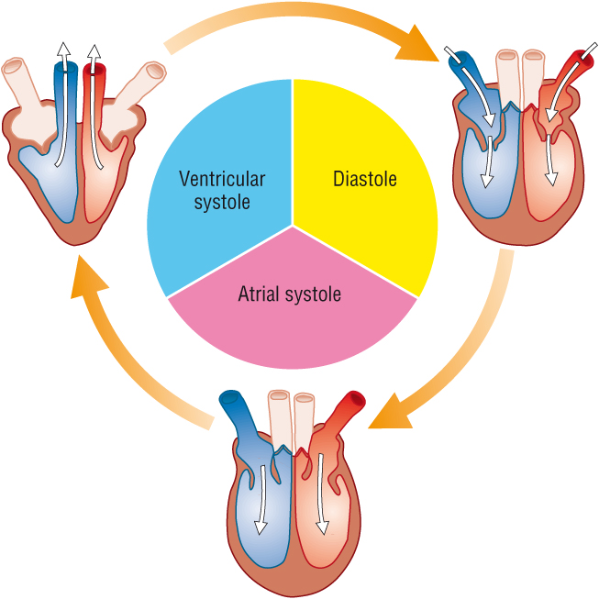
Describe the cardiac cycle with reference to the action of the valves in the heart.

Slide 33
For animation of the cardiac cycle and explanation of the changes in pressure that take place
http://library.med.utah.edu/kw/pharm/hyper_heart1.html

Slide 34
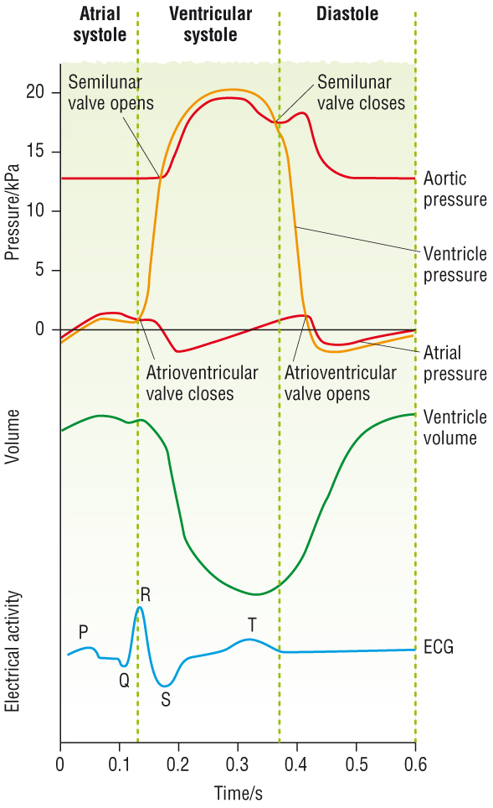
Be able to link changes in pressure and volume shown on the graph with the stages of the cardiac cycle.

Slide 35
Control of the Cardiac cycle Read text book pages 58-59
Make notes on the meaning of:
Myogenic
Sinoatrial node
Atrioventricular node
Purkyne (Purkinje) tissue

Slide 36
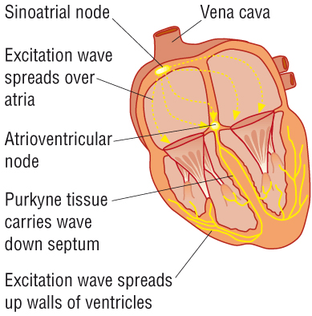
Control of the cardiac cycle
Non –conducting
tissue

Slide 37
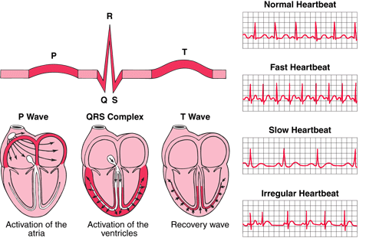
Interpret and explain electrocardiogram (ECG) traces with reference to normal and abnormal heart activity.

Slide 38
ECG interpretation
P-R interval (usually 0.12 to 0.2 secs) greater than 0.2 secs means a delay in the transmission of the excitation wave to the ventricles due to damage to the AV node or Purkine tissue
QRS complex is usually 0.06 to 0.1 sec in duration, if longer it indicates problems with the conduction of the excitation wave across the ventricles.
Small unclear P waves indicate atrial fibrillation due to damage to the SAN, this means that the ventricles are not filled during atrial systole, so ventricle contraction doesn’t expel the normal amount of blood.
No regular PQRS pattern discernible indicates fibrillation of the atria and ventricles, uncoordinated weak contractions of the chambers so that blood is not pumped out of the heart effectively.
Deep S waves indicate an increase in ventricle thickness due to increase in blood pressure.

Slide 39
Interpret and explain electrocardiogram (ECG) traces with reference to normal and abnormal heart activity.
P shows atrial excitation just prior to atrial systole
QRS shows ventricle excitation that causes ventricular systole
T shows repolarisation of the heart muscle during diastole
Top ECG normal
Any changes to the shape and length of each section of the trace can indicate heart abnormalities
Raised ST section indicates heart attack, no ion pumps workinging to repolarise cells
Fibrillation is unco-ordinated contraction of either / or / both atria and ventricles
Hypertrophy: extra muscle growth to overcome increased blood pressure due to blockages in blood vessels

