Slide 1
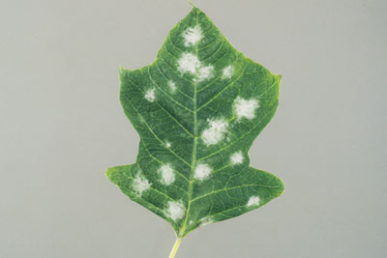
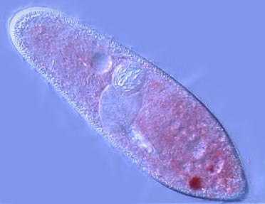
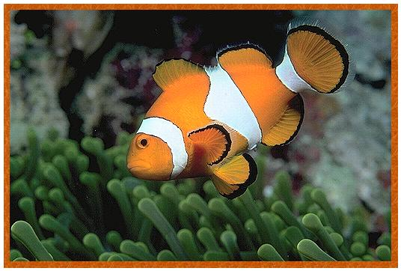
Classification
Go to Section:

Slide 2
The Challenge
Biologists have identified and named approximately 1.5 million species so far.
They estimate that between 2 and 100 million species have yet to be identified.

Slide 3
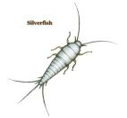
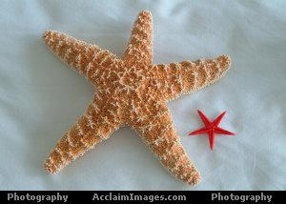
Finding Order in Diversity
1. Why Classify?
To study the diversity of life
To organize and name organisms
2. Why give scientific names?
Common names are misleading
jellyfish
silverfish
star fish
None of these animals are fish!
Go to Section:

Slide 4
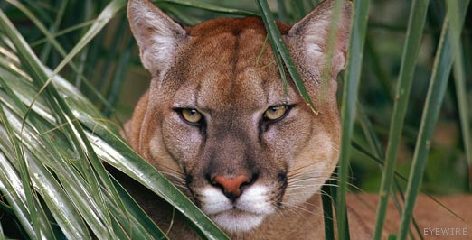
Why Scientists Assign Scientific Names to Organisms
Some organisms have several common names
This cat is commonly known as:
Florida panther
Mountain lion
Puma
Cougar
Scientific name: Felis concolor
Scientific name means “coat of one color”
Go to Section:

Slide 5
Origin of Scientific Names
By the 18th century, scientists realized that naming organisms with common names was confusing.
Scientists during this time agreed to use a single name for each species.
They used Latin and Greek languages for scientific names.

Slide 6
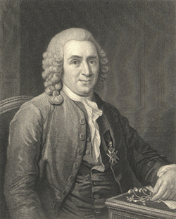
Slide # 6
Linnaeus: The Father of Modern Taxonomy
1732: Carolus Linnaeus developed system of classification – binomial nomenclature
Two name naming system
Gave organisms 2 names
Genus (noun) and species (adjective)
Rules for naming organisms
1. Written is Latin (unchanging)
2. Genus capitalized, species lowercase
3. Both names are italicized or underlined
EX: Homo sapiens: wise / thinking man
Carolus Linnaeus
Go to Section:

Slide 7
Linnaeus’s System of Hierarchy
Least specific
Kingdom
Which of the following contains all of the others?
Family c. Class
Species d. Order
Based on their names, you know that the baboons Papio annubis and Papio cynocephalus do not belong to the same:
Family c. Order
Genus d. Species
Phylum
Class
Order
Family
Genus
Most specific
Species
Go to Section:

Slide 8
Binomial Nomenclature Example
For example, the polar bear is named Ursus maritimus.
The genus, Ursus, describes a group of closely related bear species.
In this example, the species, maritimus, describes where the polar bear lives—on pack ice floating on the sea.

Slide 9
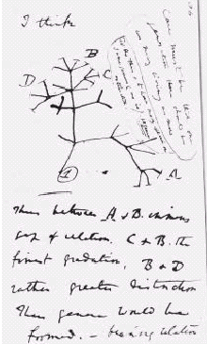
Modern Classification
Linnaeus grouped species into larger taxa, such as genus and family, based on visible similarities.
Darwin’s ideas about descent with modification evolved into the study of phylogeny, or evolutionary relationships among organisms.

Slide 10
Modern Classification
Modern biologists group organisms into categories representing lines of evolutionary descent.
Species within a genus are more closely related to each other than to species in another genus.
Genus: Felis
Genus: Canis

Slide 11
Similarities in DNA and RNA
Scientists use similarities and differences in DNA to determine classification and evolutionary relationships.
They can sequence or “read” the information coded in DNA to compare organisms.

Slide 12
Kingdoms and Domains
In the 18th century, Linnaeus originally proposed two kingdoms: Animalia and Plantae.
By the 1950s, scientists expanded the kingdom system to include five kingdoms.

Slide 13
The Five Kingdom System

Slide 14
The Six Kingdom System
In recent years, biologists have recognized that the Monera are composed of two distinct groups.
As a result, the kingdom Monera has now been separated into two kingdoms: Eubacteria and Archaebacteria, resulting in a six-kingdom system of classification.

Slide 15
The Three-Domain System
Scientists can group modern organisms by comparing ribosomal RNA to determine how long they have been evolving independently.
This type of molecular analysis has resulted in a new taxonomic category—the domain.

Slide 16
The Three Domains
The three domains, which are larger than the kingdoms, are the following:
Eukarya – protists, fungi, plants and animals
Bacteria – which corresponds to the kingdom Eubacteria.
Archaea – which corresponds to the kingdom Archaebacteria.

Slide 17
Classification of Living Things
The three-domain system
Bacteria
Archaea
Eukarya
The six-kingdom system
Eubacteria
Archae-
bacteria
Protista
Plantae
Fungi
Animalia

Slide 18
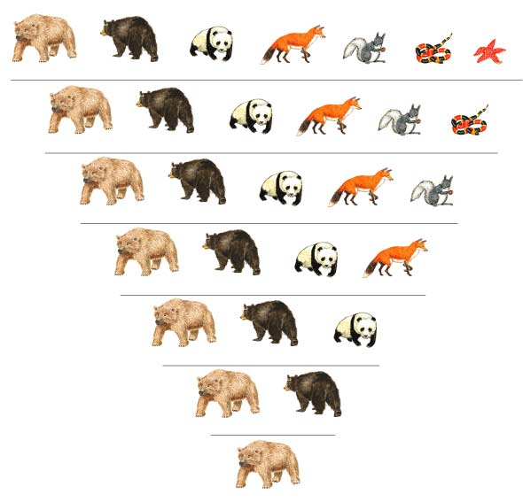
Hierarchical Ordering of Classification
Grizzly bear
Black bear
Giant panda
Red fox
Abert squirrel
Coral snake
Sea star
KINGDOM Animalia
PHYLUM Chordata
CLASS Mammalia
As we move from the kingdom level to the species level, more and more members are removed.
Each level is more specific.
ORDER Carnivora
FAMILY Ursidae
GENUS Ursus
SPECIES Ursus arctos
Go to Section:

Slide 19
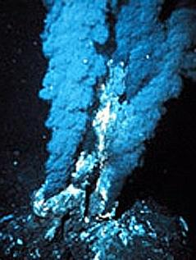
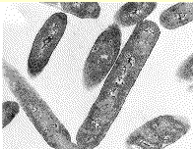
Kingdom Archaebacteria
Cell Type | Prokaryote
Number of Cells | Unicellular
Nutrition | Autotroph or Heterotroph
Location | Extreme Environments Volcanoes, Deep Sea Vents, Yellowstone Hot Springs
Examples | Methanogens Thermophiles
Go to Section:

Slide 20
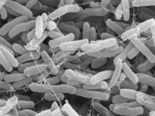
Kingdom Eubacteria
Cell Type | Prokaryote
Number of Cells | Unicellular
Nutrition | Autotroph or Heterotroph
Examples | Streptococcus, Escherichia coli (E. coli)
E. coli
Streptococcus
Go to Section:

Slide 21
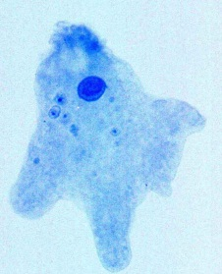
Kingdom Protista
Cell Type | Eukaryote
Number of Cells | Most Unicellular, some multicellular
Nutrition | Autotroph or Heterotroph
Examples | Amoeba, Paramecium, Euglena,
Paramecium
Green algae
The “Junk-Drawer” Kingdom
Amoeba
Go to Section:

Slide 22
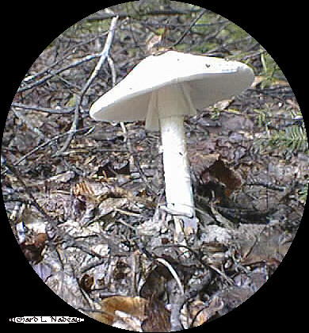
Kingdom Fungi
Cell Type | Eukaryote
Number of Cells | Most multicelluar, some unicelluar
Nutrition | Heterotroph
Example | Mushroom, yeast, mildew, mold
Mildew on Leaf
Most Fungi are DECOMPOSERS
Mushroom
Go to Section:

Slide 23
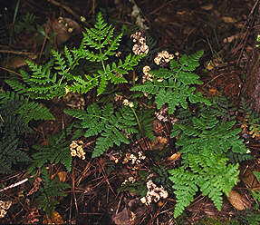
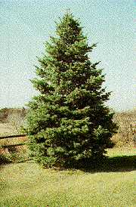
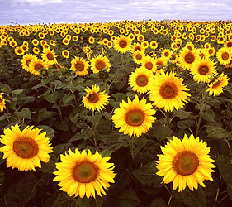
Kingdom Plantae
Ferns : seedless vascular
Cell Type | Eukaryote
Number of Cells | Multicellular
Nutrition | Autotroph
Examples | Mosses, ferns, conifers, flowering plants
Douglas fir: seeds in cones
Mosses growing on trees
Sunflowers: seeds in flowers
Go to Section:

Slide 24
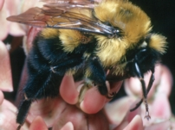
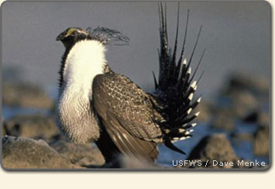
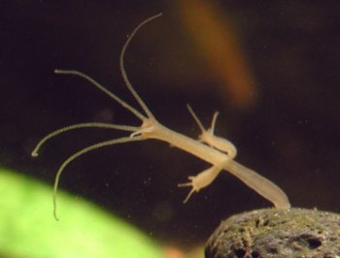
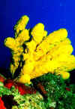
Kingdom Animalia
Cell Type | Eukaryote
Number of Cells | Multicellular
Nutrition | Heterotroph
Examples | Sponges, worms, insects, fish, mammals
Bumble bee
Jellyfish
Sage grouse
Hydra
Poison dart frog
Sponge
Go to Section:

