Slide 1
ELECTRICAL CIRCUITS

Slide 2
The CELL
The cell stores chemical energy and transfers it to electrical energy when a circuit is connected.
When two or more cells are connected together we call this a Battery.
The cells chemical energy is used up pushing a current round a circuit.

Slide 3
What is an electric current?
An electric current is a flow of microscopic particles called electrons flowing through wires and components.
-
+
In which direction does the current flow?
from the Negative terminal to the Positive terminal of a cell.

Slide 4
simple circuits
Here is a simple electric circuit. It has a cell, a lamp and a switch.
cell
wires
switch
lamp
To make the circuit, these components are connected together with metal connecting wires.

Slide 5
simple circuits
When the switch is closed, the lamp lights up. This is because there is a continuous path of metal for the electric current to flow around.
If there were any breaks in the circuit, the current could not flow.

Slide 6
circuit diagram
Scientists usually draw electric circuits using symbols;
cell
lamp
switch
wires

Slide 7
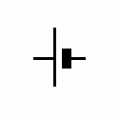
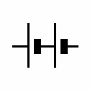
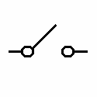
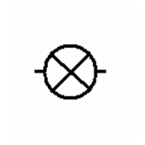
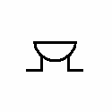
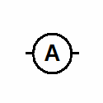
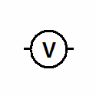
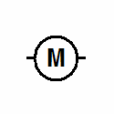
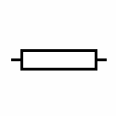
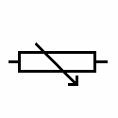
circuit diagrams
In circuit diagrams components are represented by the following symbols;
cell
battery
switch
lamp
buzzer
ammeter
voltmeter
motor
resistor
variable resistor

Slide 8
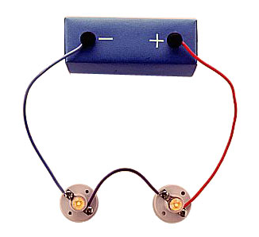
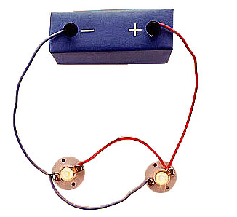
types of circuit
There are two types of electrical circuits;
SERIES CIRCUITS
PARALLEL CIRCUITS

Slide 9
SERIES CIRCUITS
The components are connected end-to-end, one after the other.
They make a simple loop for the current to flow round.
If one bulb ‘blows’ it breaks the whole circuit and all the bulbs go out.

Slide 10
PARALLEL CIRCUITS
The components are connected side by side.
The current has a choice of routes.
If one bulb ‘blows’ there is still be a complete circuit to the other bulb so it stays alight.

Slide 11
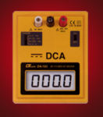
measuring current
Electric current is measured in amps (A) using an ammeter connected in series in the circuit.
A

Slide 12
measuring current
This is how we draw an ammeter in a circuit.
A
A
SERIES CIRCUIT
PARALLEL CIRCUIT

Slide 13
measuring current
SERIES CIRCUIT
current is the same
at all points in the
circuit.
2A
2A
2A
PARALLEL CIRCUIT
2A
2A
current is shared
between the
components
1A
1A

Slide 14
copy the following circuits and fill in the missing ammeter readings.
?
?
3A
3A
4A
?
1A
?
4A
4A
1A
?
1A

Slide 15
measuring voltage
The ‘electrical push’ which the cell gives to the current is called the voltage. It is measured in volts (V) on a voltmeter
V

Slide 16
measuring voltage
Different cells produce different voltages. The bigger the voltage supplied by the cell, the bigger the current.
Unlike an ammeter a voltmeter is connected across the components
Scientist usually use the term Potential Difference (pd) when they talk about voltage.

Slide 17
measuring voltage
This is how we draw a voltmeter in a circuit.
V
V
SERIES CIRCUIT
PARALLEL CIRCUIT

Slide 18
measuring voltage
V
V
V
V

Slide 19
series circuit
voltage is shared between the components
3V
1.5V
1.5V

Slide 20
parallel circuit
voltage is the same in all parts of the circuit.
3V
3V
3V

Slide 21
measuring current & voltage
copy the following circuits on the next two slides.
complete the missing current and voltage readings.
remember the rules for current and voltage in series and parallel circuits.

Slide 22
measuring current & voltage
a)
6V
4A
A
V
V
A

Slide 23
measuring current & voltage
b)
6V
4A
A
V
A
V
A

Slide 24
answers
a)
b)
6V
6V
4A
4A
6V
4A
4A
3V
3V
2A
4A
6V
2A

