Slide 1
Forage Crops

Slide 2
David S. Seigler
Department of Plant Biology
University of Illinois
Urbana, Illinois 61801 USA seigler@life.illinois.edu http://www.life.illinois.edu/seigler

Slide 3
Forages - Outline
Importance:
Temperate vs. tropical
Natural vs. cultivated
Botanical:
Poaceae
Fabaceae
Storage:
Hay
Ensilage

Slide 4
Properties:
Protein (legumes)
Carbohydrate
"Roughage" Ruminants
Cultivation:
Europe-Asia origin
Special problems in tropics
Side products
Bees

Slide 5
Most important forage crop
Alfalfa

Slide 6
Reading
CHAPTERS 5 (pp. 134-135) AND 6 (pp. 153-154) IN TEXT.

Slide 7
Introduction
Forage crops mainly consist of members of the Fabaceae (Leguminosae) and Poaceae (Gramineae).

Slide 8
Introduction
Cumulatively, the value of forage crops is comparable to non-forage cultivated plants.
In the world there are about 1.5 X 10⁹ hectares (3.7 X 10⁹ acres) of arable land. There are 3 X 10⁹ hectares (7.5 X 10⁹ acres) of pasture lands.
In North America, they are about equal. In Europe and S.E. Asia, there is more arable land. In S. America, most of Asia, and Africa there is more pasture land.

Slide 9
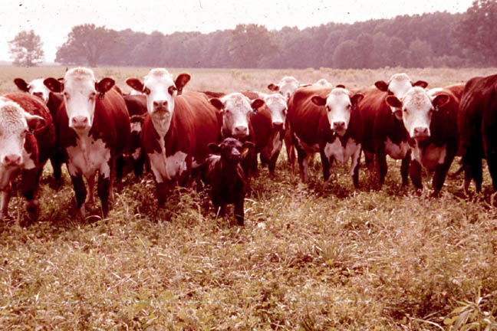
University of Illinois, College of Agriculture

Slide 10
Nutrition
Nutritionally, young grass is up to 20% dry weight protein. Usually about 10%.
In the U.S., the value of forage crops is about $10 X 10⁹ per year.
For most parts of the world, production figures are difficult to obtain as forage crops are often grown and consumed on the same farm.
Only recently have people started to systematically fertilize, breed, and make hybrid forages.

Slide 11
Grasses and legumes often sown together.
In temperate areas, millets, sudan grass, oats, rye, Trifolium subterraneum, Medicago sativa, and other legumes are widely cultivated.
In cold areas of the world, harvested and preserved forage crops are essential in order to feed cattle and other livestock through long winters.

Slide 12
Cereal grains and root crops
All common cereal grains are used to feed livestock as well as humans.
In Europe and Asia, many root crops such as beets, turnips and potatoes are also used to feed animals.

Slide 13
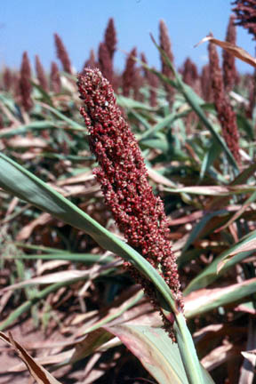
Sorghum bicolor, grain sorghum

Slide 14
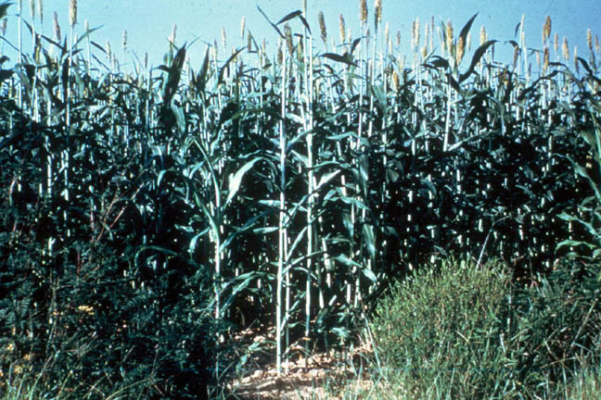
Sorghum bicolor, cane sorghum
Carolina Biological Supply Co.

Slide 15
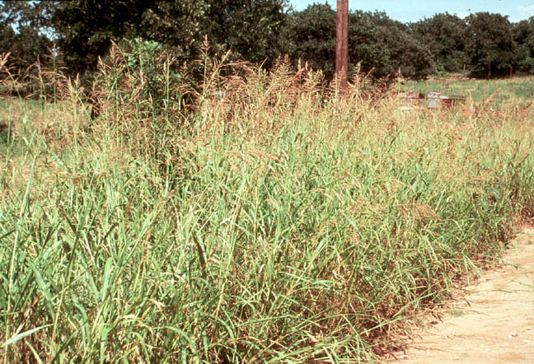
Johnson grass, Sorghum halepense

Slide 16
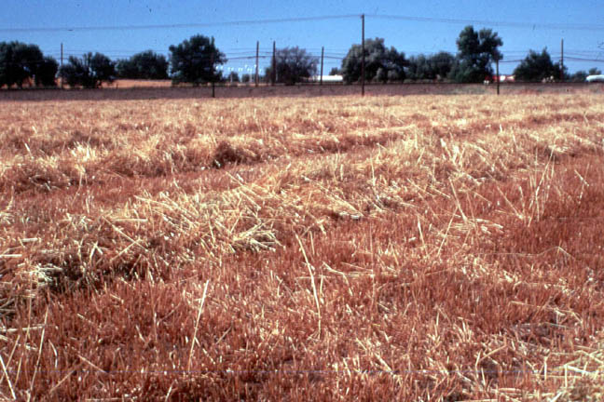
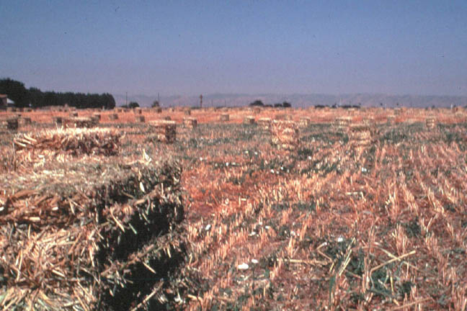
Straw in the Central Valley, California

Slide 17
Hay and ensilage
Forage crops may be used directly or made into hay or into silage.
Hay produced by reducing the moisture content of fresh plant material 15% water or less.
Hay quality is determined by what species are involved, the amount of leaf material in comparison to stem material, the time the forage was harvested, and the amount of weathering and handling the material has undergone.

Slide 18
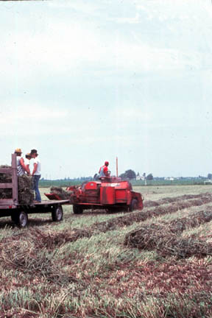
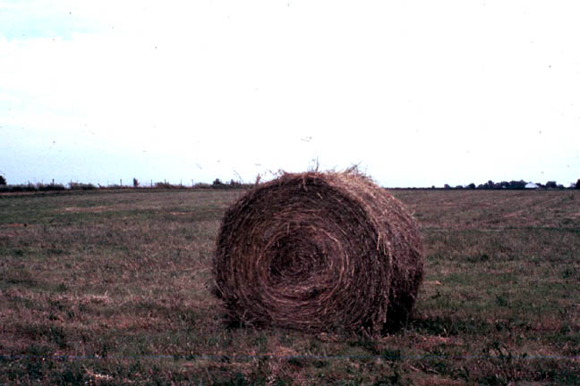
Hay production in Central Illinois

Slide 19
Ensilage
Ensilage is made by anaerobic fermentation of undried forage or the stalks of corn or sorghum.
Ensilage is rich in water.
During fermentation, the acid content rises and preserves the plant material.

Slide 20

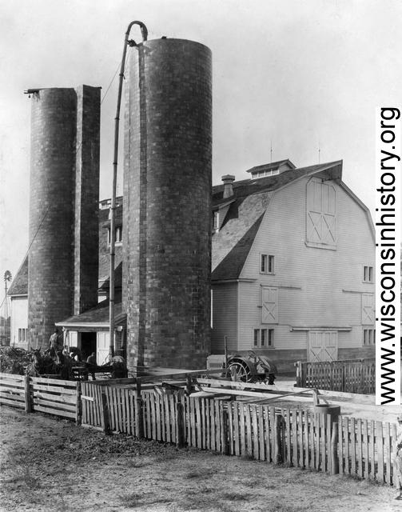
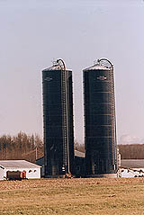
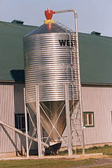
Ensilage and silos

Slide 21
Cultivated forage crops
Most cultivated forage crops from Europe or Asia.
Most forage crops perennials, but some are annuals.
Pg. 135. Major forage grasses.

Slide 22
Grasses, Poaceae or Gramineae
Many native and introduced grasses used for pasturage.
Some are cultivated and improved through breeding.

Slide 23
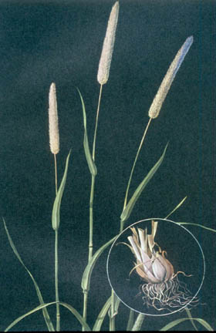
Timothy, Phleum pratense
Introduced Grasses and Legumes, Sect. 6, Pasture and Range Plants, Phillips Petroleum Co., 1960.

Slide 24
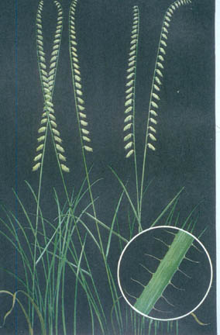
Bouteloua curtipendula, side oats grama
Introduced Grasses and Legumes, Sect. 1, Pasture and Range Plants, Phillips Petroleum Co., 1960.

Slide 25
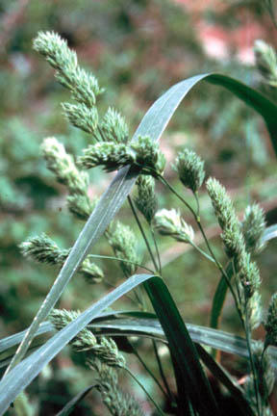
Dactylis glomeratus, orchard grass

Slide 26
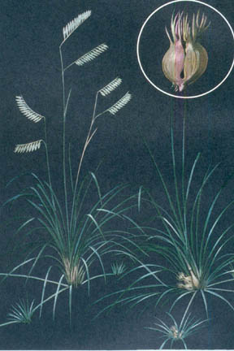
Buchloe dactyloides, buffalo grass
Introduced Grasses and Legumes, Sect. 1, Pasture and Range Plants, Phillips Petroleum Co., 1960.

Slide 27
Legume forage crops
Many of the same things apply to forage legumes as for grasses.
Legumes fix nitrogen.
Table of forage legumes pg. 153.
Many legume forage crops are also excellent bee plants.

Slide 28
Legume forage crops
Animals tend not to do well on fields of pure legumes. They do best with a mixture of grasses and legumes.
Most of the cultivated species of legume forage crops come from Europe, Africa and Asia.

Slide 29
Alfalfa (Medicago sativa)
Alfalfa is the most important forage legume.
Alfalfa or lucerne (Medicago sativa) cultivated for thousands of years. Grown today on all continents except Antarctica.
More than 33 million hectares cultivated worldwide.
Cultivated types are tetraploids.
Wild diploids are found in the Near East. These probably represent the ancestral species of the cultivated crop.

Slide 30
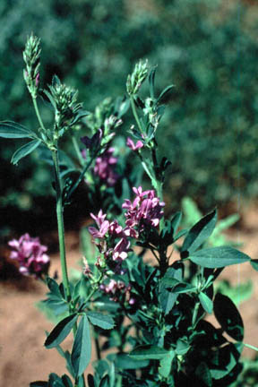
Alfalfa or lucerne, Medicago sativa

Slide 31
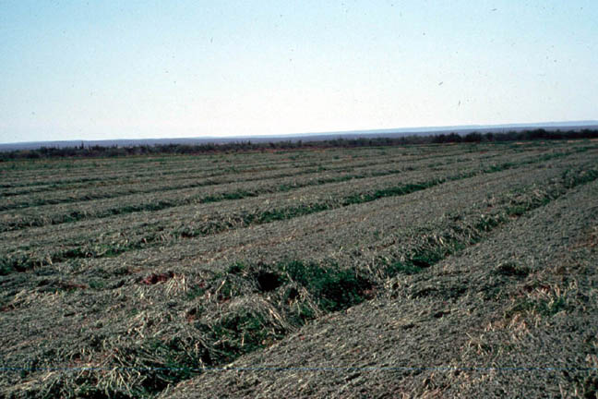
Alfalfa in Baja California Sur

Slide 32
Used by the Romans. Was a favorite forage for chariot horses.
Commonly grown in Spain and introduced from there into the New World.
Introduced into California from Chile during the Gold Rush in 1848-1850.
Until about 1900, this crop could not be grown well in the North because of the lack of cold hardiness. Since then, hardy varieties have been developed.

Slide 33
Alfalfa a perennial grown from seed.
6-9 cuttings per year can be made under ideal conditions.
Alfalfa somewhat salt and drought tolerant.
Makes excellent fodder (but is slightly toxic to many animals). Must be mixed with other forages.
U.S., Argentina, France major growers.

Slide 34
Clovers (Trifolium spp. )
Clovers are the second most important group of forage plants. Also natives of Europe and Asia.
White clover, Trifolium repens, and red clover, Trifolium pratense, often 20-30% protein.
Probably the most commonly grown forages in the U.S.
Often planted with grasses.
Some toxicity problems associated with clovers.

Slide 35
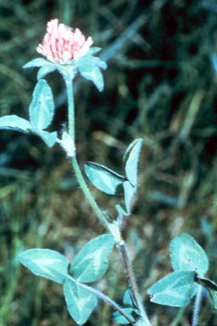
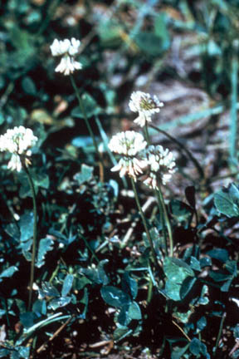
Trifolium repens, white clover
Trifolium incarnata, red clover

Slide 36
Sweet clover, lespedeza, and birdsfoot trefoil
Sweet clover (Melilotus alba and M. officinalis) also important forage crops. These species are at times toxic.
Many lespedeza species from Asia. Now found widely. Introduced in 1919 into the U.S.
Birdsfoot trefoil from Europe and Asia. Common in the Northeastern U.S. where heavy soils predominate. Also somewhat toxic at times.

Slide 37
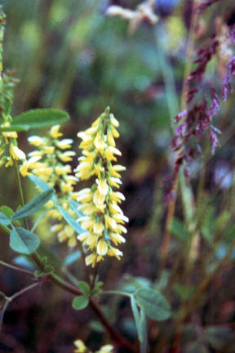
Melilotus officinalis, sweet clover

Slide 38
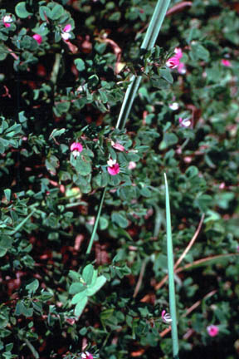
Lespedeza cuneata, lespedeza

Slide 39
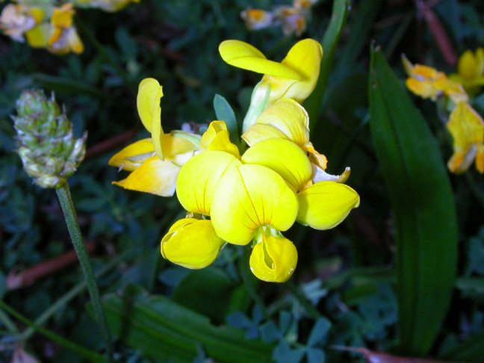
Birdsfoot trefoil, Lotus corniculatus

Slide 40
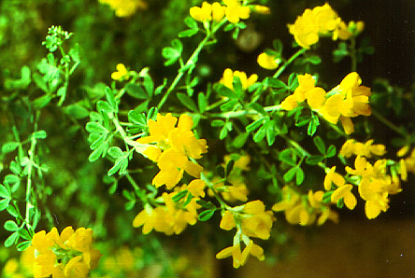
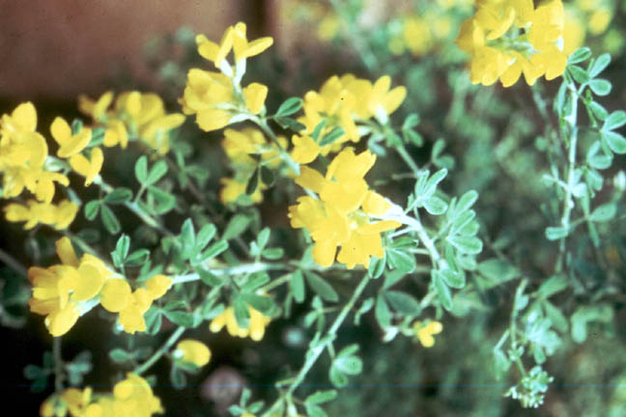
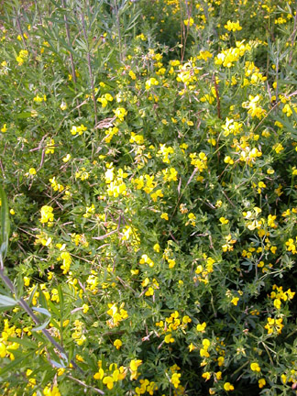
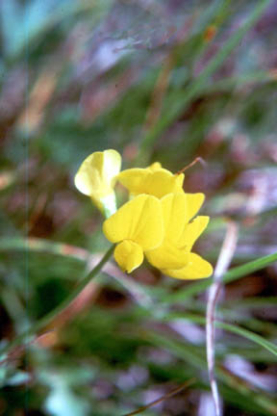
Birdsfoot trefoil

Slide 41
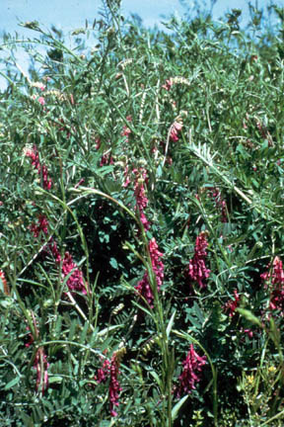
Vicia angustisifolia, vetch

Slide 42
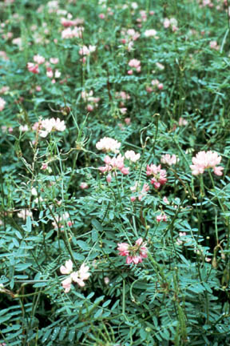
Coronilla varia, crown-vetch

Slide 43
Forage plants in the tropics
Forage plants becoming more and more common in the tropics.
In relatively temperate areas, millets, sudan grass, oats, rye,Trifolium subterraneum, Medicago, and other legumes widely cultivated.
In warm tropical areas, Napier fodder [Setaria (Panicum) purpureum] and guinea grass or indio [Megathyrsus (Panicum) maximus] and the legumes (Pueraria phaseoloides) and Glycine wightii widely grown.

Slide 44
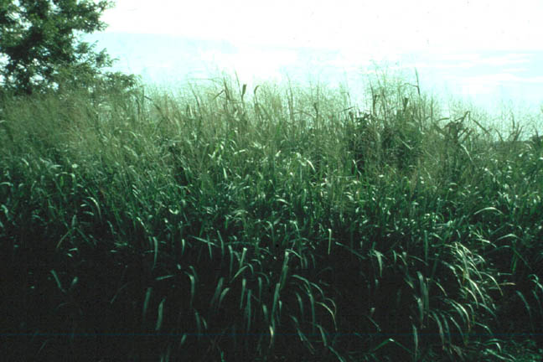
Megathyrsus (Panicum) maximus, guinea grass or indio

Slide 45
In recent years, many types of legume forage crops that are small trees or shrubs have been planted.
Examples are Acaciella angustissima, Leucaena leucocepahala and Indigofera spicata.
Although they produce a lot of protein and are good forage plants, all have some toxicity problems.

Slide 46
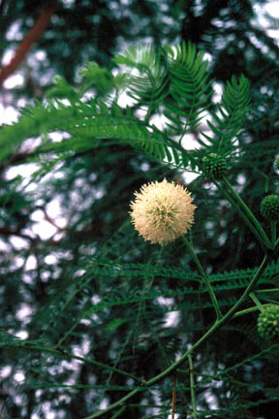
Leucaena leucocephala

Slide 47
Indigofera hendecaphylla Jacq. (Indigofera spicata)
flickr.com/photos/chiaubun/2474219846/

