Slide 1
Farm Machinery (part 2)
AO 125

Slide 2
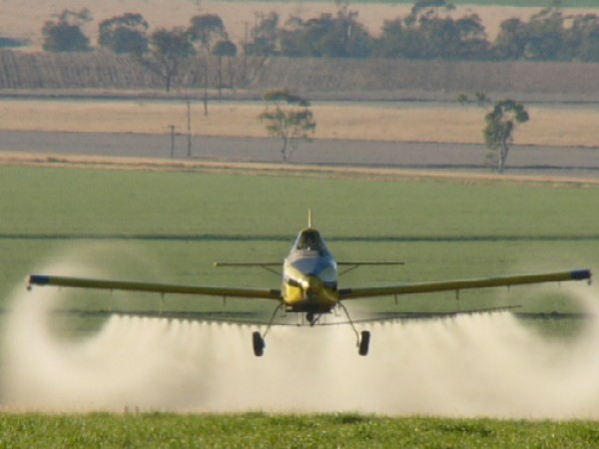
Name it? Category?

Slide 3
Aerial Sprayer (airplane) Sprayer

Slide 4
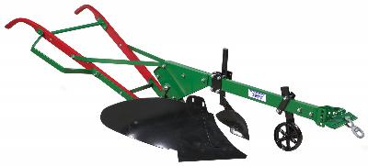
Name it? Category?

Slide 5
Moldboard Plow Primary-tillage implement

Slide 6
Moldboard Plow (cont) Know what a Back Furrow is

Slide 7
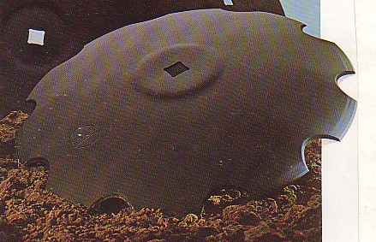
Type of disk?

Slide 8
Stubble Disk

Slide 9
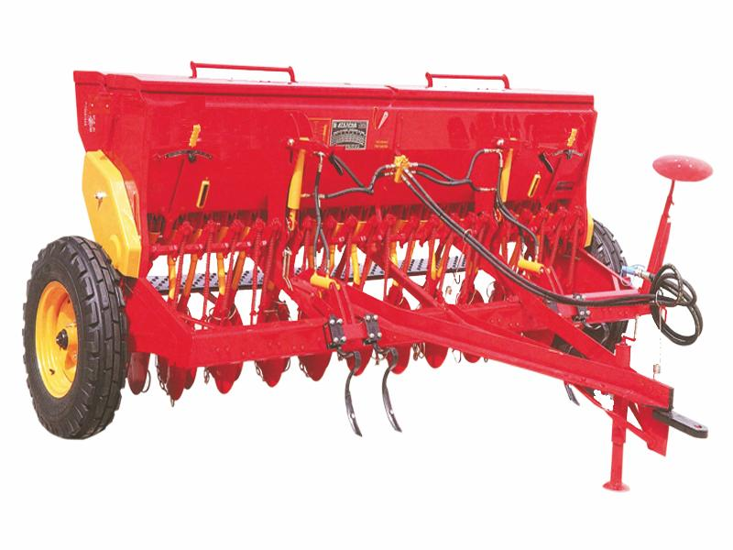
Name it? Category

Slide 10
Drill Planting equipment

Slide 11
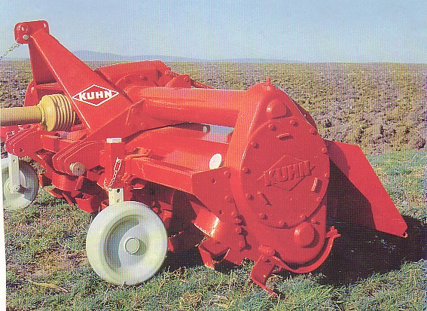
Name it? Category?

Slide 12
Rotary Tiller Primary Tillage Implement

Slide 13
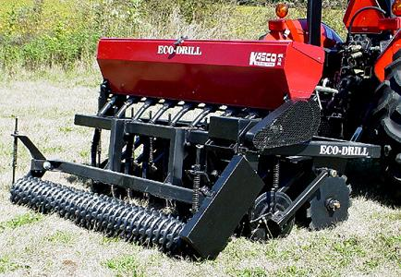
Name it? Category?

Slide 14
No-till drill Planting equipment

Slide 15
Name it? Category?

Slide 16
Ripper or Subsoiler Primary-tillage implement

Slide 17
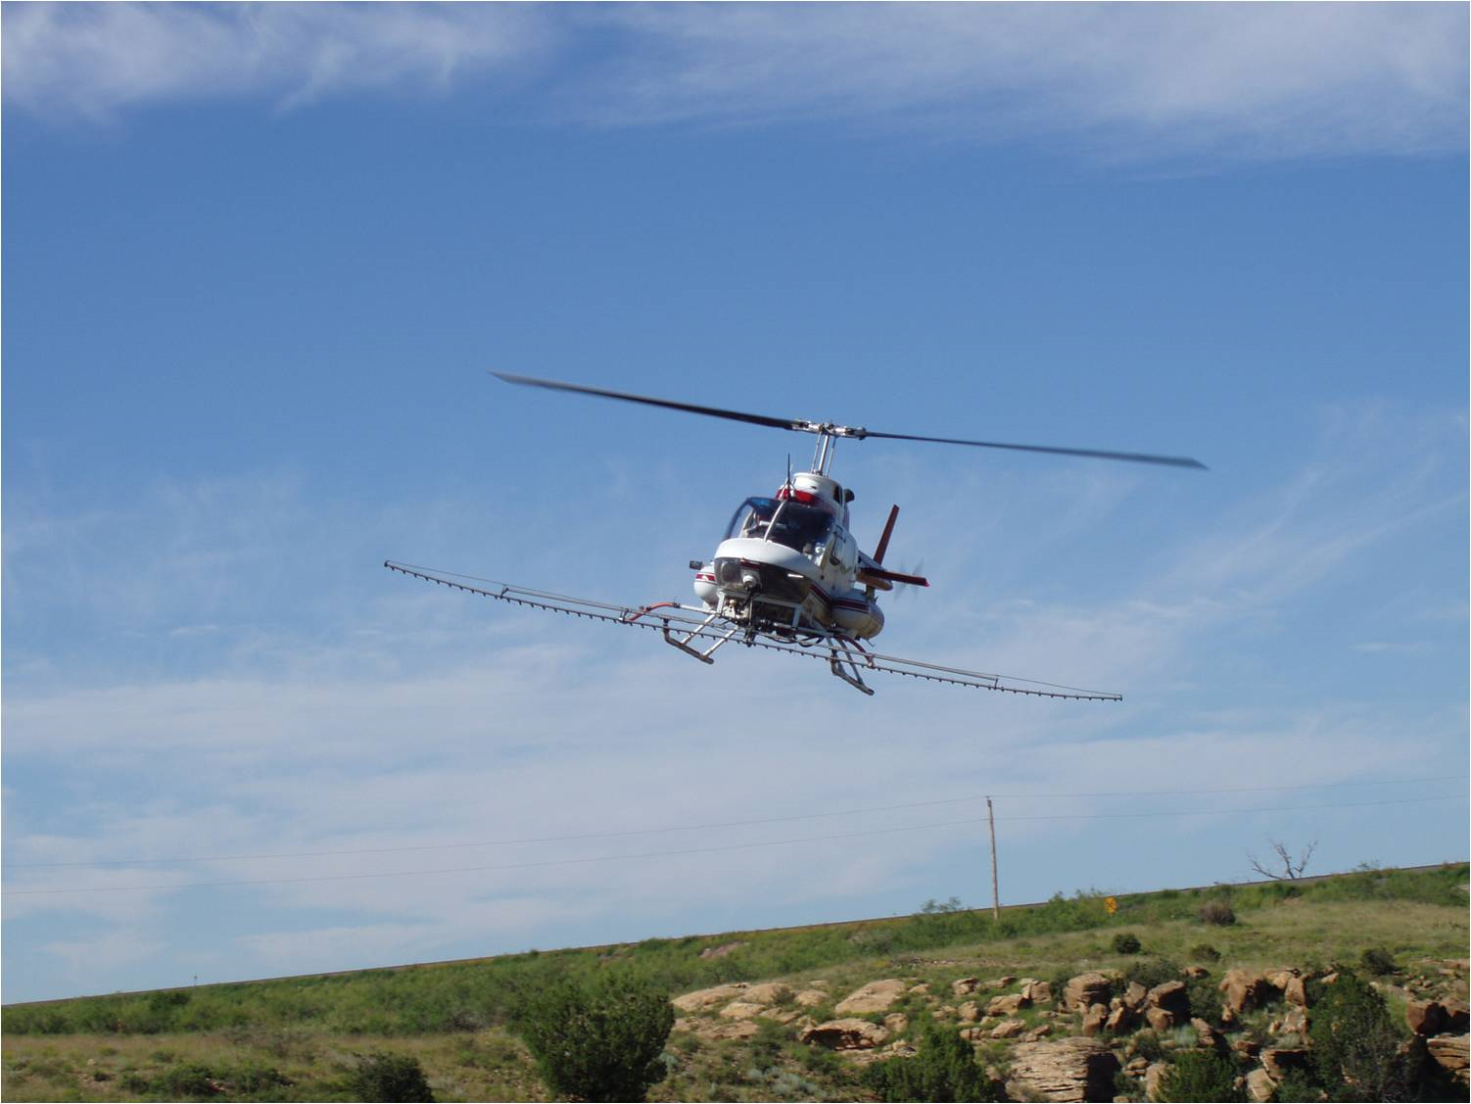
Name it? Category

Slide 18
Aerial Sprayer (helicopter) Sprayer

Slide 19
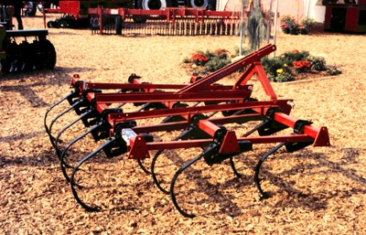
Name it? Category?

Slide 20
Field Cultivator Secondary

Slide 21
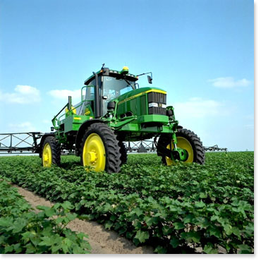
Name it? Category?

Slide 22
Ground Sprayer (Self Propelled) Sprayer

Slide 23
Name it? Category?

Slide 24
Rotary Hoe Secondary-tillage implement

Slide 25
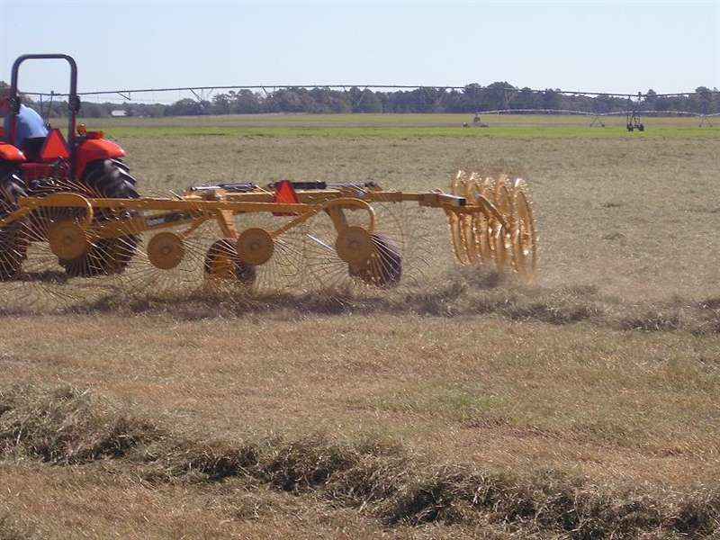
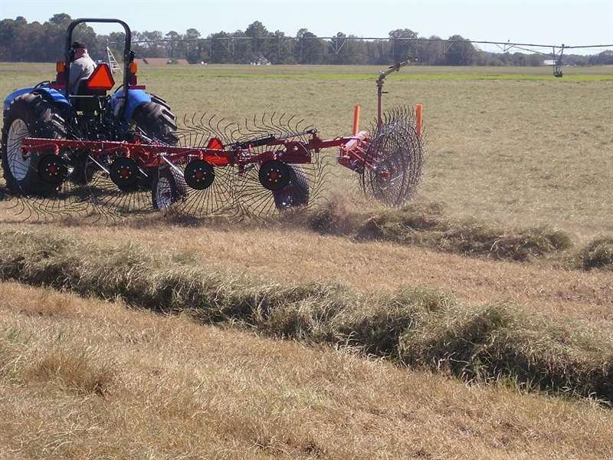
Name it? Category?

Slide 26
Wheel Rake Harvest equipment

Slide 27
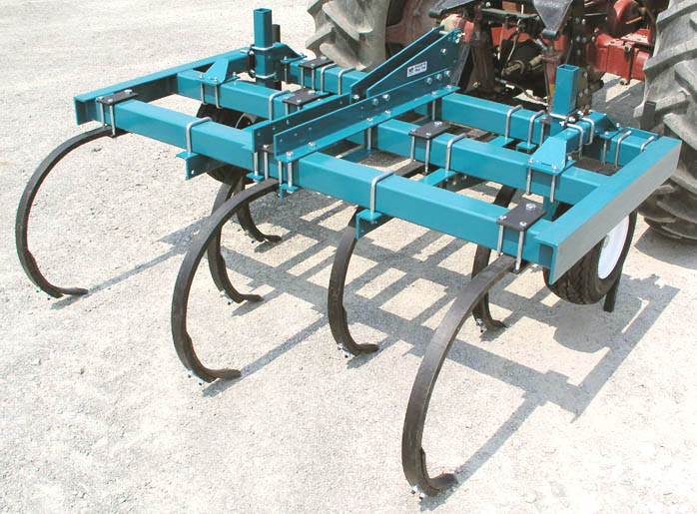
Name it? Category?

Slide 28
Chisel Plow Primary Tillage Implement

Slide 29
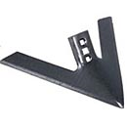
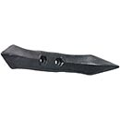
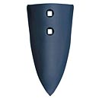
Name each part of a chisel plow or field cultivator

Slide 30
Sweeps
Points
Shovels

Slide 31
Name it? Category

Slide 32
Drill Planting equipment

Slide 33
Name it? Category?

Slide 34
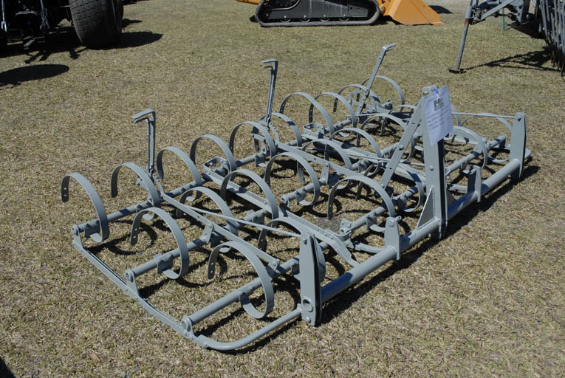
Spring-tooth Harrow Secondary-tillage implement

Slide 35
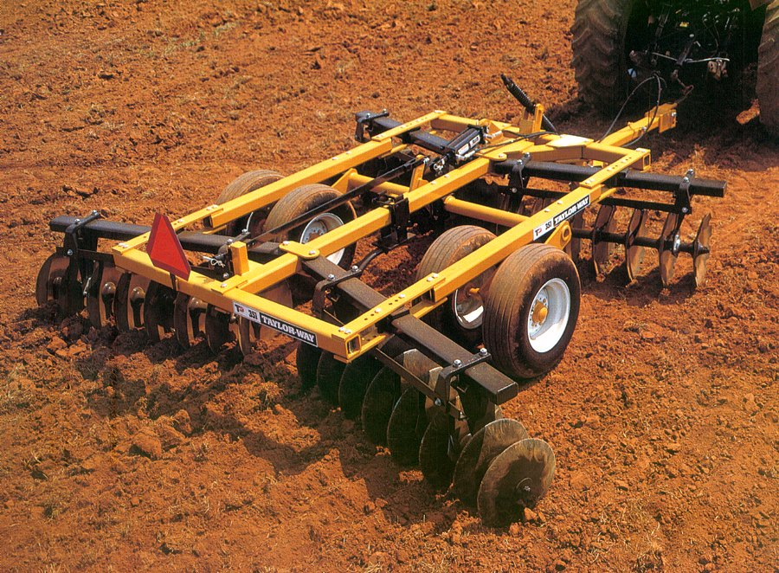
Name it? Category?

Slide 36
Double Disk or Tandem Disk Primary-tillage implement

Slide 37
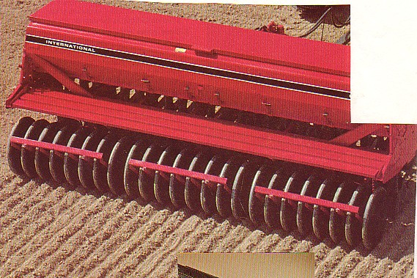
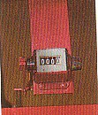
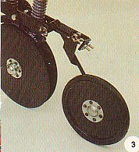
Name the machine, and the circled device

Slide 38
Drill
Acre Meter

Slide 39
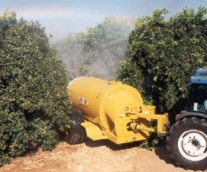
Name it? Category?

Slide 40
Orchard Sprayer Sprayer

Slide 41
Name it? Category?

Slide 42
Spike-tooth Harrow Secondary-tillage implement

Slide 44
No-till Drill

Slide 45
Name it? Category?

Slide 46
Row-crop Planter Planting equipment

Slide 47
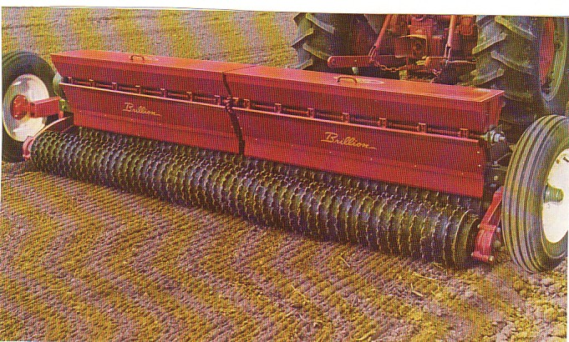
Name it? Category?

Slide 48
Drop-box Seeder Planting implement

Slide 49
Name it? Category?

Slide 50
Precision Planter Planting equipment

Slide 51
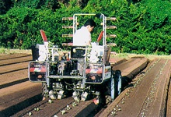
Name it? Category?

Slide 52
Transplanter Planting equipment

Slide 53
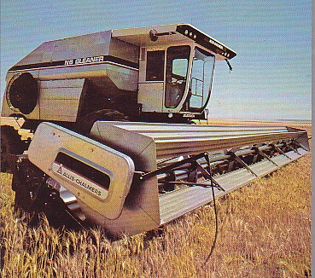
Name it? Category?

Slide 54
Combine Harvest equipment

Slide 55
What two operations does it combine?

Slide 56
It combines reaping and threshing

Slide 57
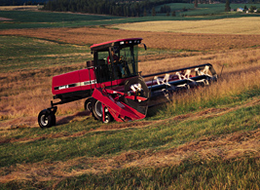
Name the implement (two names)? Name the row of plant material?

Slide 58
Windrower or Swather
Windrow

Slide 59
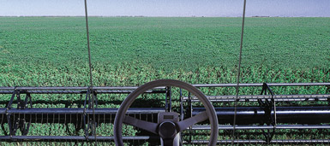
Swath: The width that the machine cuts

Slide 60
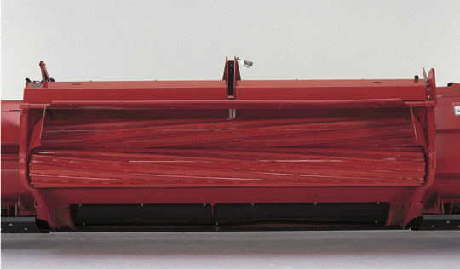
Part of a windrower?

Slide 61
Windrower: Conditioner
Opposing rollers crimp the stems so they dry faster

Slide 62
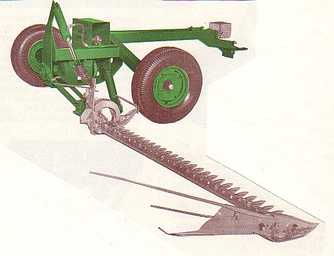
Name it? Category?

Slide 63
Sickle-bar Mower Harvest equipment

Slide 64
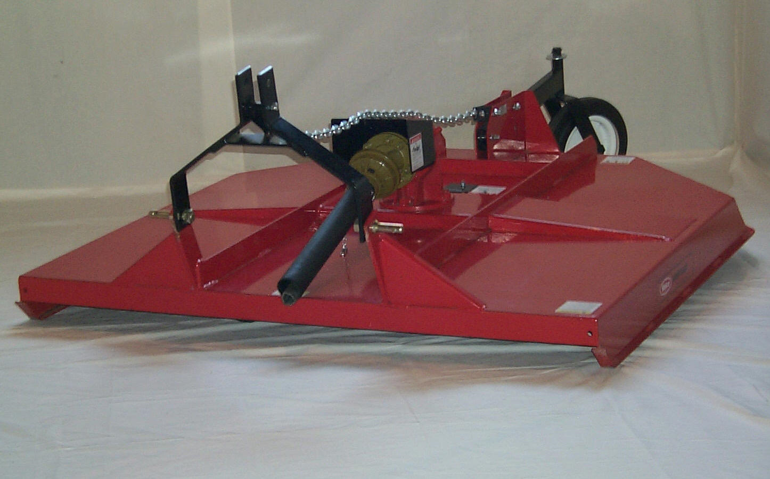
Name it? Category?

Slide 65
Rotary Mower Harvest Equipment

Slide 66
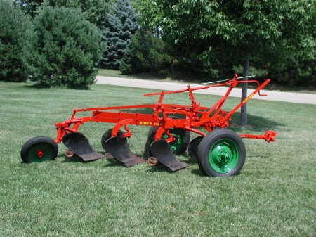
Name the machine? What is one of these called?

Slide 67
Moldboard Plow Plow share

Slide 68
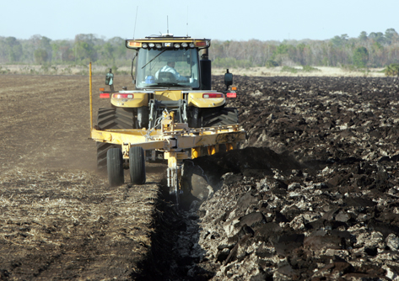
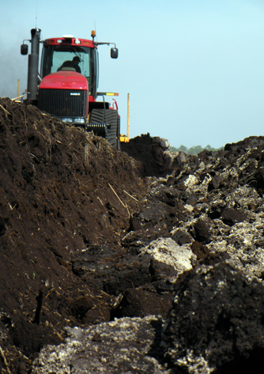
The ditch is called what?
The next round fills in the

Slide 69
Moldboard Plow, Dead Furrow
The next round fills in the Dead Furrow

Slide 70
Name it? Category?

Slide 71
Reel Mower Harvest Equipment

Slide 72
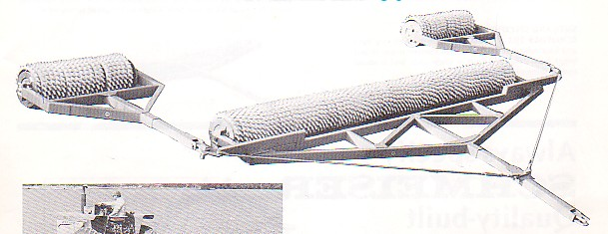
Name it? Category?

Slide 73
Ring roller Secondary-tillage implement

Slide 74
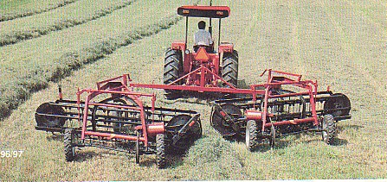
Name it? Category?
Note the Windrow

Slide 75
Side-delivery Rake Harvest equipment
Note the Windrow

Slide 76
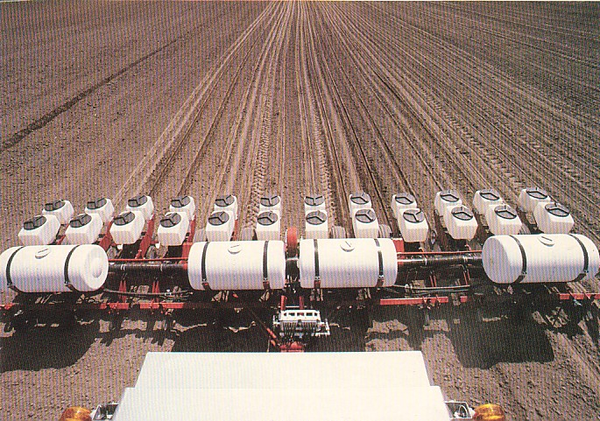
Name it? Category?

Slide 77
Row-crop Planter Planting equipment

Slide 78
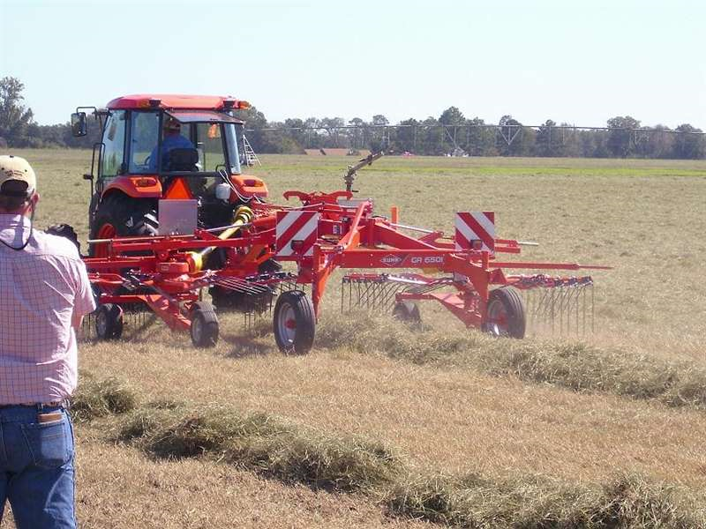
Name it? Category?

Slide 79
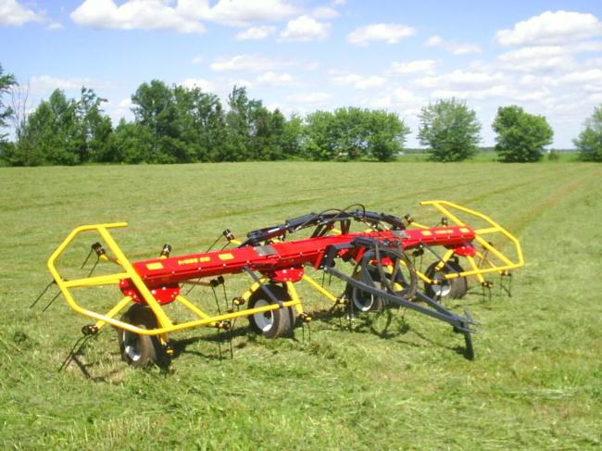
Tedder Harvest Equipment

Slide 80
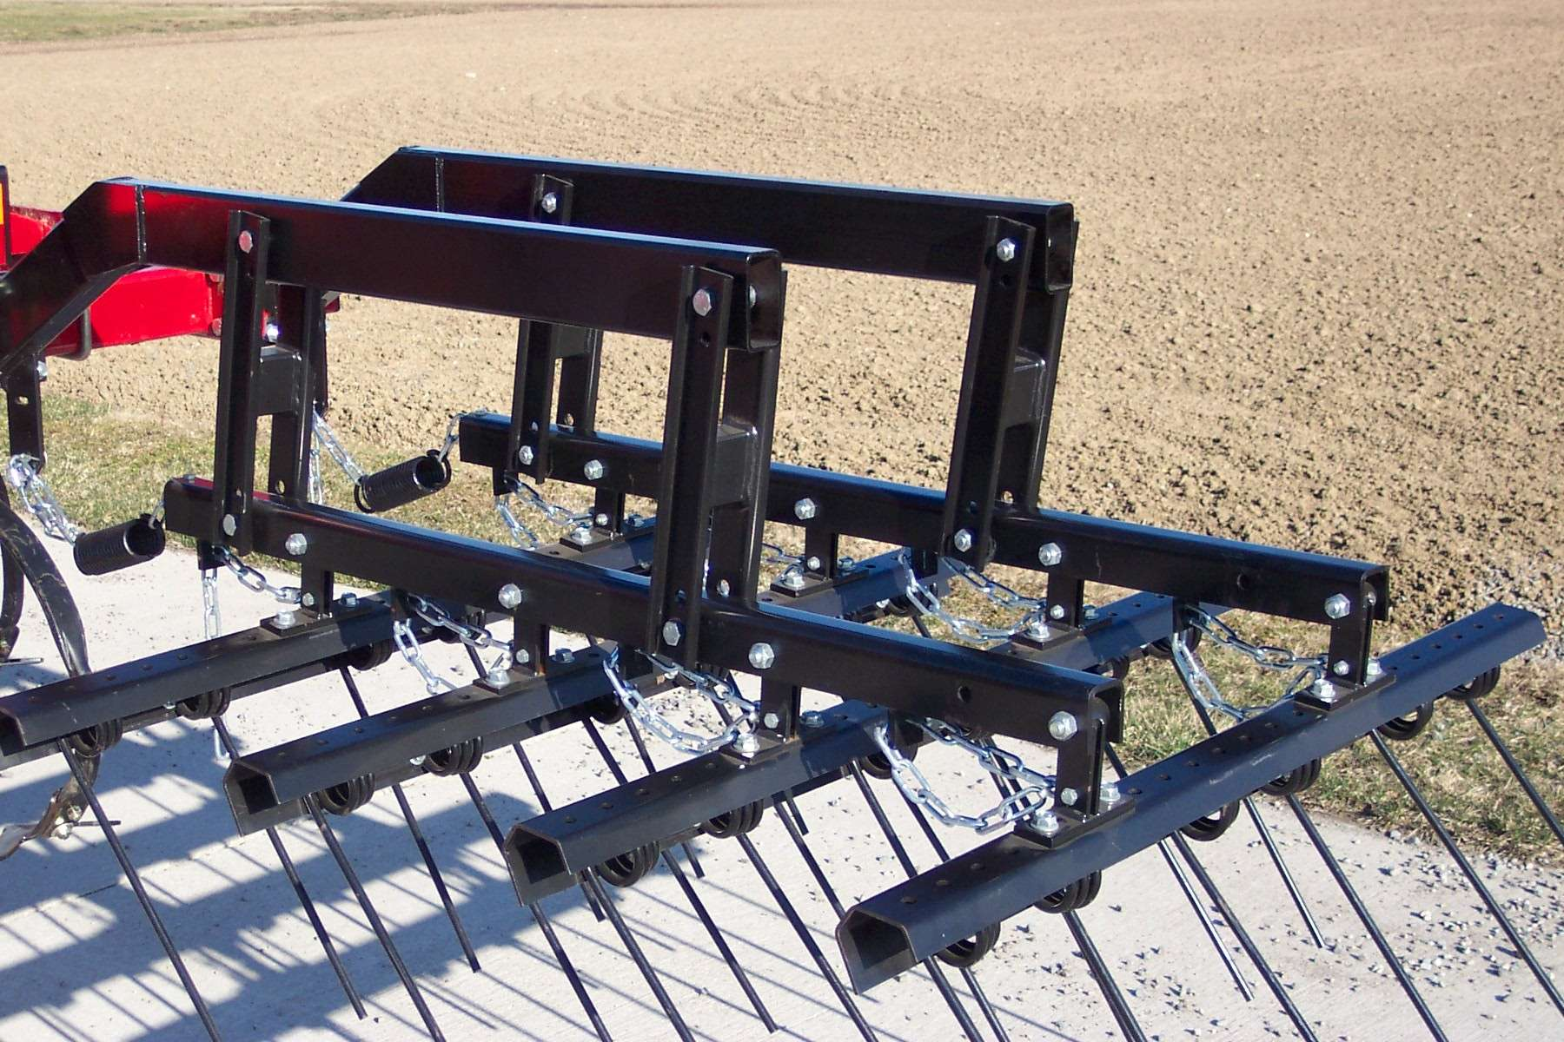
Name it? Category?

Slide 81
Spring-tine Harrow Secondary-tillage implement

Slide 82
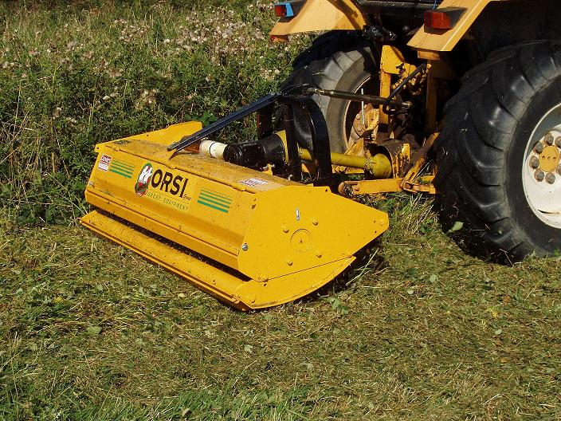
Name it? Category?

Slide 83
Flail Mower Harvest equipment

Slide 84
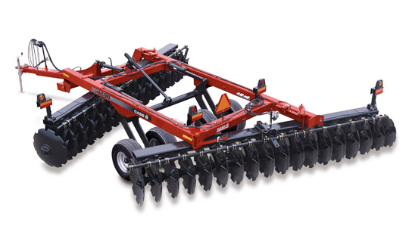
Name it? Category?

Slide 85
Offset Disk Primary-tillage implement

Slide 86
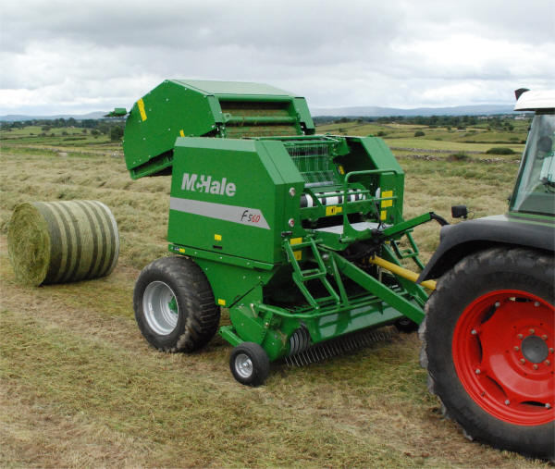
Name it? Category?

Slide 87
Round Baler Harvest equipment

Slide 88
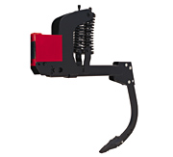
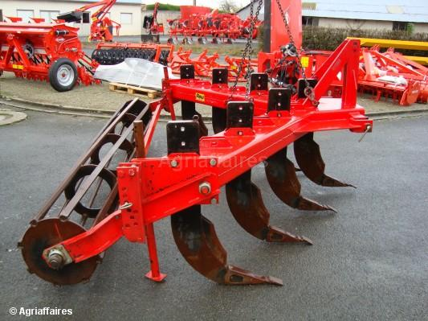
Name it (two names)? Category?

Slide 89
Ripper or Subsoiler Primary-tillage implement

Slide 90
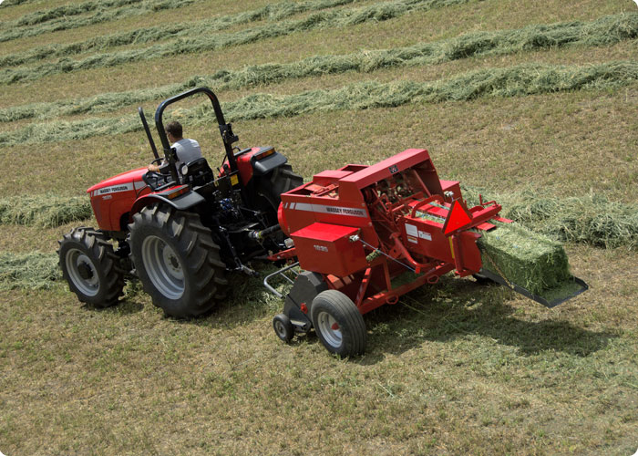
Name it? Category?

Slide 91
Square Baler Harvest equipment

Slide 92
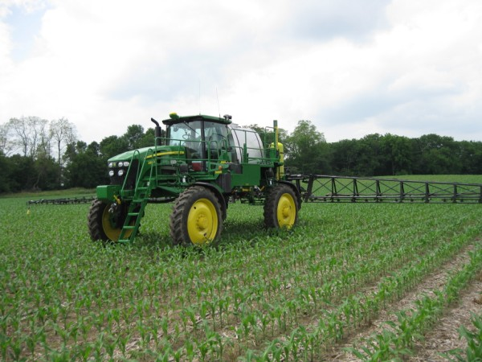
Name it? Category?

Slide 93
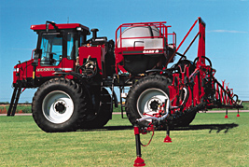
Ground Sprayer Sprayer

