Slide 1
The Promise of Salvation
You Are Predestined

Slide 2
You Are Predestined
From Ephesians 1: 3-14
In love He predestined us for adoption through Jesus Christ……
In Him we have redemption through His blood, the forgiveness of our sins, according to the riches of His grace, which He lavished upon us, in all wisdom and insight making known to us the mystery of his will …

Slide 3
Predestined
This isn’t a cold-hearted determination or
pre-set fate
It is a loving choice on God’s part
And God had and continues to have a plan for us

Slide 4
The Thread of Salvation
Starting at Genesis 3:15
Genesis Jonah
Exodus Micah
Leviticus Nahum
Numbers Habakkuk
Deuteronomy Zephaniah
Joshua Haggai
Judges Zechariah
Ruth Malachi
1,2 Samuel Matthew
1,2 Kings Mark
1,2 Chronicles Luke
Ezra John
Nehemiah Acts
Ester Romans
Job 1,2 Corinthians
Psalms Galatians
Proverbs Ephesians
Ecclesiastes Philippians
Song of Solomon Colossians
Isaiah 1,2 Thessalonians
Jeremiah 1,2 Timothy
Lamentations Titus
Ezekiel Philemon
Daniel Hebrews Hosea James
Joel 1,2 Peter
Amos 1,2,3 John
Obadiah Jude
Revelation Ending at Revelation 22:21

Slide 5
God’s Thread of Salvation
From the beginning it has been a battle
Adam
Cain murders Abel
Noah and the flood
Abraham and his promise
Isaac
Joseph
Moses
Joshua
Isaiah
Jeremiah
Daniel
David

Slide 6
Amos the Sheep Breeder
The Hebrew word for sheep breeder indicates he was a owner of flocks of sheep, not a hired shepherd
Amos describes himself in Amos 7:14 as “a dresser of sycamore figs”.
Western Judah, the oasis of Jericho and lower Galilee were places where sycamore figs grew abundantly
The shepherds brought their flocks here in late summer after the desert pastures dried up.
They could watch their flocks while sitting in the broad limbs of the sycamore piercing its fruit

Slide 7
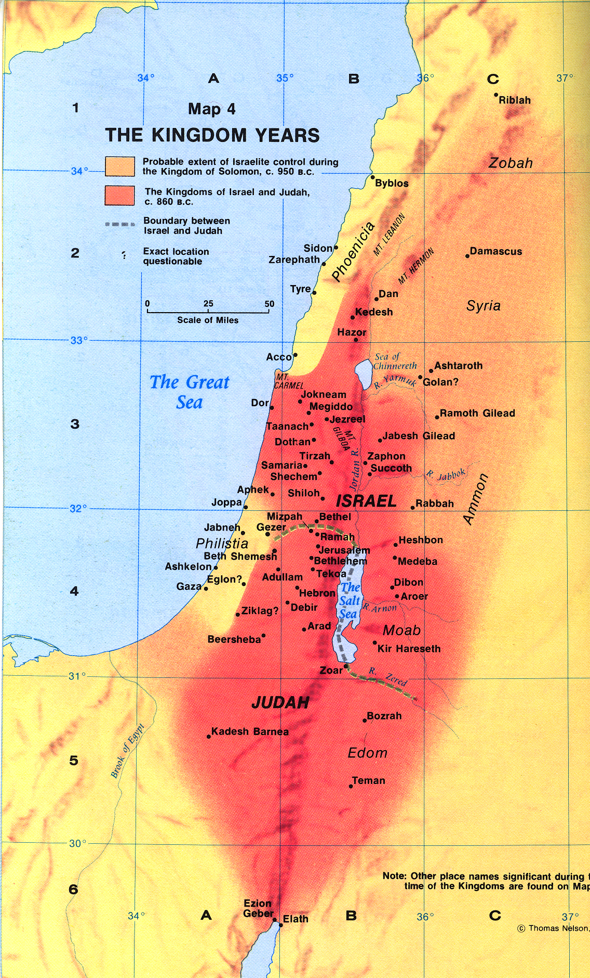

Slide 8
Amos the Prophet
In Hebrew Amos means “Burden-Bearer”
He was called to warn people of their approaching doom
Life was good, they didn’t listen
Amos was expelled from Israel to Judah by Amaziah and Jeroboam
But the course of judgment cannot be changed

Slide 9
Gospel Lesson Mark 6: 14 - 29
Herod has John The Baptist beheaded
Why? Because John publicly called Herod into account for taking and marrying his brother’s wife, Herodias
Herod feared that Jesus was the resurrected John The Baptist
Herod was both frightened and curious

Slide 10
Which Herod?
There are three Herods in the New Testament
Herod the Great – Died in 4 BC. Ordered the killing of all baby boys at the time of Jesus’ birth
Herod Antipas One of his sons, the one who had John the Baptist murdered and before whom Jesus was tried
Herod Philip, whose wife was taken by his brother Herod Antipas

Slide 11
The Crowning Glory
The Birth
The Life and Teaching
The Crucifixion
The Resurrection
The Ascension of
Jesus Christ
Our Lord and Savior

Slide 12
Spiritual Warfare
Throughout History there has been spiritual warfare
As long as sin exists the battle between Satan’s forces and God’s people will rage on
The Christian life is a battleground – not a playground
The sooner we accept this truth the easier it will be to win the battle

Slide 13
What Can We Do?
Paul tells what to do in Ephesians 6
We are to put on the armor and use the weapons God has given us

Slide 14
The Armor of God
The belt of Truth
The breastplate of Righteousness
The shoes of Peace
The shield of Faith
The helmet of Salvation
The sword of the Spirit

Slide 15
Our Responsibilities
We must stand so we do not lose the ground Jesus won for us
We must know our enemies
We must use the equipment God provides
We must depend on the energy God provides.

Slide 16
Our Enemies
The world, the flesh and the Devil
“We wrestle not against flesh and blood, but against principalities”
Satan is not an abstraction. He is real
He uses people for his evil purposes
He is strong and powerful
His strategies and wiles are subtle and deadly
He is well organized
We cannot win this battle on our own.
We need God’s power through prayer to win

Slide 17
We Must Use God’s Equipment
We must use all the equipment God gives us
When great men and women of the Bible sinned they always fell in the areas of their greatest personal strength
We must know the basis of our belief and apply it in our everyday life
Prayer is the greatest armor of all

Slide 18
Satan’s Weapons Against Us
Crises in our lives
Sickness, Job or Financial Loss, Broken Relationships
Self Importance
Ego, Pride, Lust for Power or Money
How he hits us
Fear, anger, doubt, depression, self pity

Slide 19
The Sure Defense
Faith in God’s Person – that He exists and is actively involved in our lives.
Faith in God’s promises – His word contains answers to every problem we face.
Faith in God’s Providence – No matter what kind of battle we are in God is always in control and will protect us.

Slide 20
Salvation is Easy
Salvation is easy. Walking the walk is difficult
God left a helper for us, the Holy Spirit
God has given us His word
God has given us the guidelines of how we are to live
We have the forgiveness of Jesus Christ

Slide 21
Victory
God’s strength will allow us to
“Fight the Good Fight” and stand victorious before the throne of Jesus Christ, our Lord and God
And He will say to us
“Well done good and faithful servant”
Amen

