Slide 1
Separating Mixtures
Mixtures can be separated using different methods.
The method of separation to be used depends on:
  The state of matter of the substance to be separated.
  The physical properties of the substance to be separated.
  The component to be recovered after separation.
These methods include:
  Decanting
  Filtration
  Use of a magnet
  Simple distillation

Slide 2
  Sublimation
  Paper chromatography
  Solvent extraction
  Crystallization

Slide 3
a. Decantation.
It is a method of separating solids that can not dissolve from a liquid.
The solid to be separated is allowed to settle at the bottom of the container.
The liquid is then then carefully poured leaving the solid at the bottom of the container.
The solid that remains in the container after decanting is called Sediment.

Slide 4
Decantation can also be used to separate heterogeneous liquids that form layers by carefully pouring out the upper layer of the liquid.

Slide 5
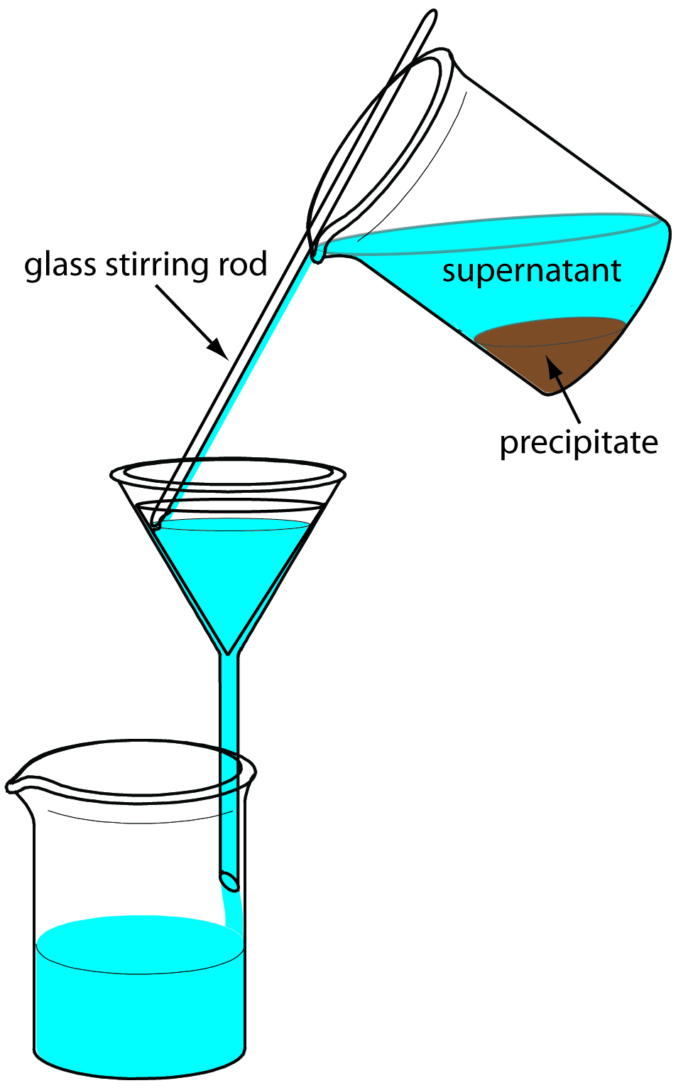

Slide 6
b. Filtration
Filtration is the process of separating solids that do not dissolve from liquids.
We use a filter that allows the liquid to pass through but not the solid.
The liquid collected after filtration is called Filtrate.
The solid left on the filtering material is called residue.

Slide 7
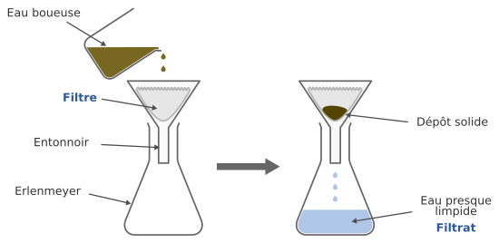

Slide 8
C. Use of a Magnet.
Magnets can be used to solid – solid mixtures.
Magnetic materials can be separated from non magnetic materials.
The magnet attracts the magnetic materials and leave behind non magnetic materials.
E.g Mixtures of: Iron fillings + flour

Slide 9
Magnetic materials include: Nickel, Iron, Chromium, Cobalt, steel, Alnico etc.
Non magnetic materials include: All non metals, Silver, Gold, Diamond etc.

Slide 10
