Slide 1
Pure and Impure Substances.
A pure substance is one that contains only one type of matter. Example; distilled water. It contains only water particles.
Most materials in nature exists as mixtures. They are not pure substances.
We can tell whether a substance is pure or impure by using its Melting point or Boiling point.

Slide 2
Pure water boils at a constant temperature. At sea level, pure water boils at 100°c.At higher altitudes water may boil at a temperature lower than 100°c.
The temperature at which a substance boils is known as Boiling point.
The boiling point of salty water is slightly above the boiling point of pure water.

Slide 3
Temperature of salty water continue rising as it continues boiling.
NB. Pure substances boil at constant temperatures while impure substances boil at varying temperatures.

Slide 4
Pure ice melts at a constant temperature. At sea level, pure ice melts at 0ºc.
The temperature at which a substance changes to a liquid is known as Melting point.
Salty ice melts at slightly lower temperature than pure ice.
The temperature continue rising as the salty ice melts.

Slide 5
NB. Pure substances melt at constant temperatures while impure substances melts at varying temperatures.
Therefore, impurities lower the melting points and raise the boiling points.

Slide 6
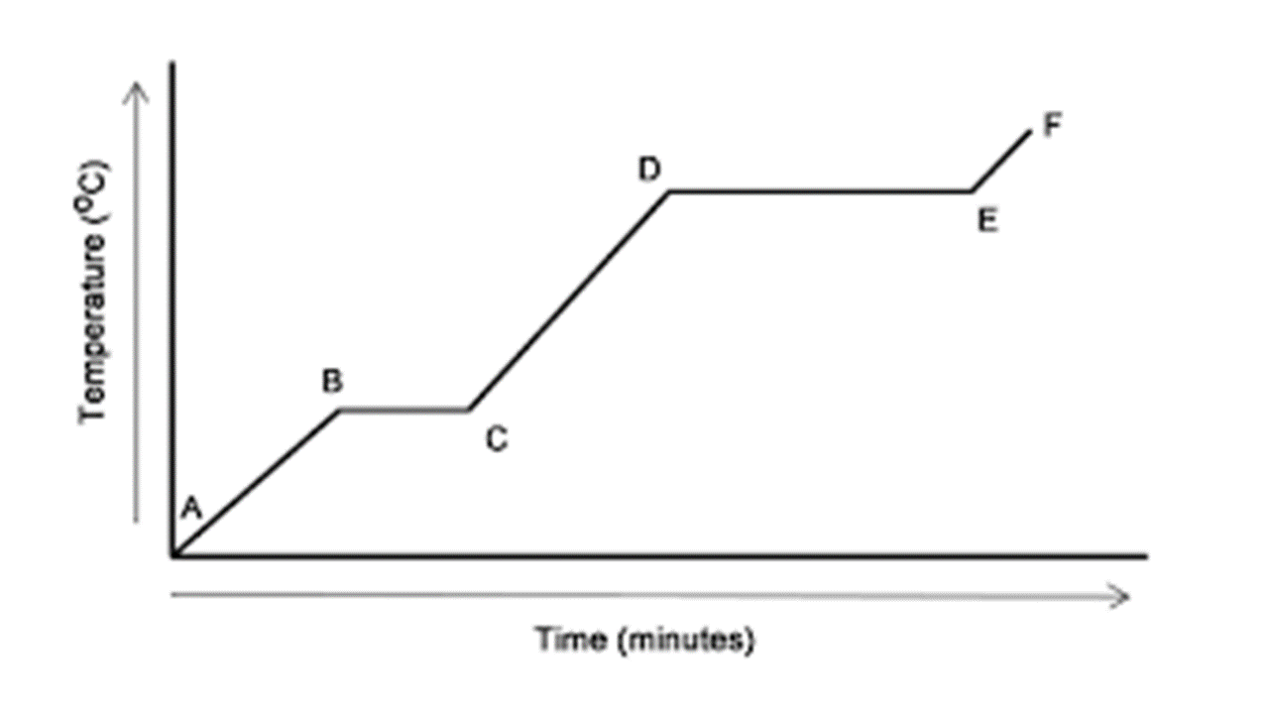
Heating curve for Pure and Impure Substance
This Photo by Unknown Author is licensed under CC BY-SA-NC

Slide 7
When a solid is heated it changes into a liquid, further heating changes the liquid into a gas.
Point A to B
When a solid is heated its temperature raises as it gains heat until it reaches its melting point.

Slide 8
Point B to C
Further heating results in change of state from solid to liquid. The temperature remains constant as the substance melts.
Point C to D
Heating a liquid increases its temperature as the liquid gains heat until it reaches its boiling point.

Slide 9
Point D to E
Further heating of the liquid results to a change of state from liquid to gas. The temperature remains constant as the liquid changes to a gas.
Point E to F
Represent heating a gas as it increases its temperature.

Slide 10
Note:
Pure substances melt and boil at constant and specific temperatures.
Melting and boiling points are used for determining purity of substances.

