Slide 1
DETERMINING THE STRENGTH OF ACIDS AND BASES.
Some acids are strong while others are weak.
Some bases are strong while others are weak.
We can differentiate between strong and weak acids or bases by use of universal indicator

Slide 2
A universal indicator is a mixture of several indicators.
It changes colour in acids and in bases depending on the strength of the solution.
The range of colours that a universal indicator can change to are interpreted using a pH chart.
A pH chart has different colours and a scale of values ranging from 0 – 14.

Slide 3
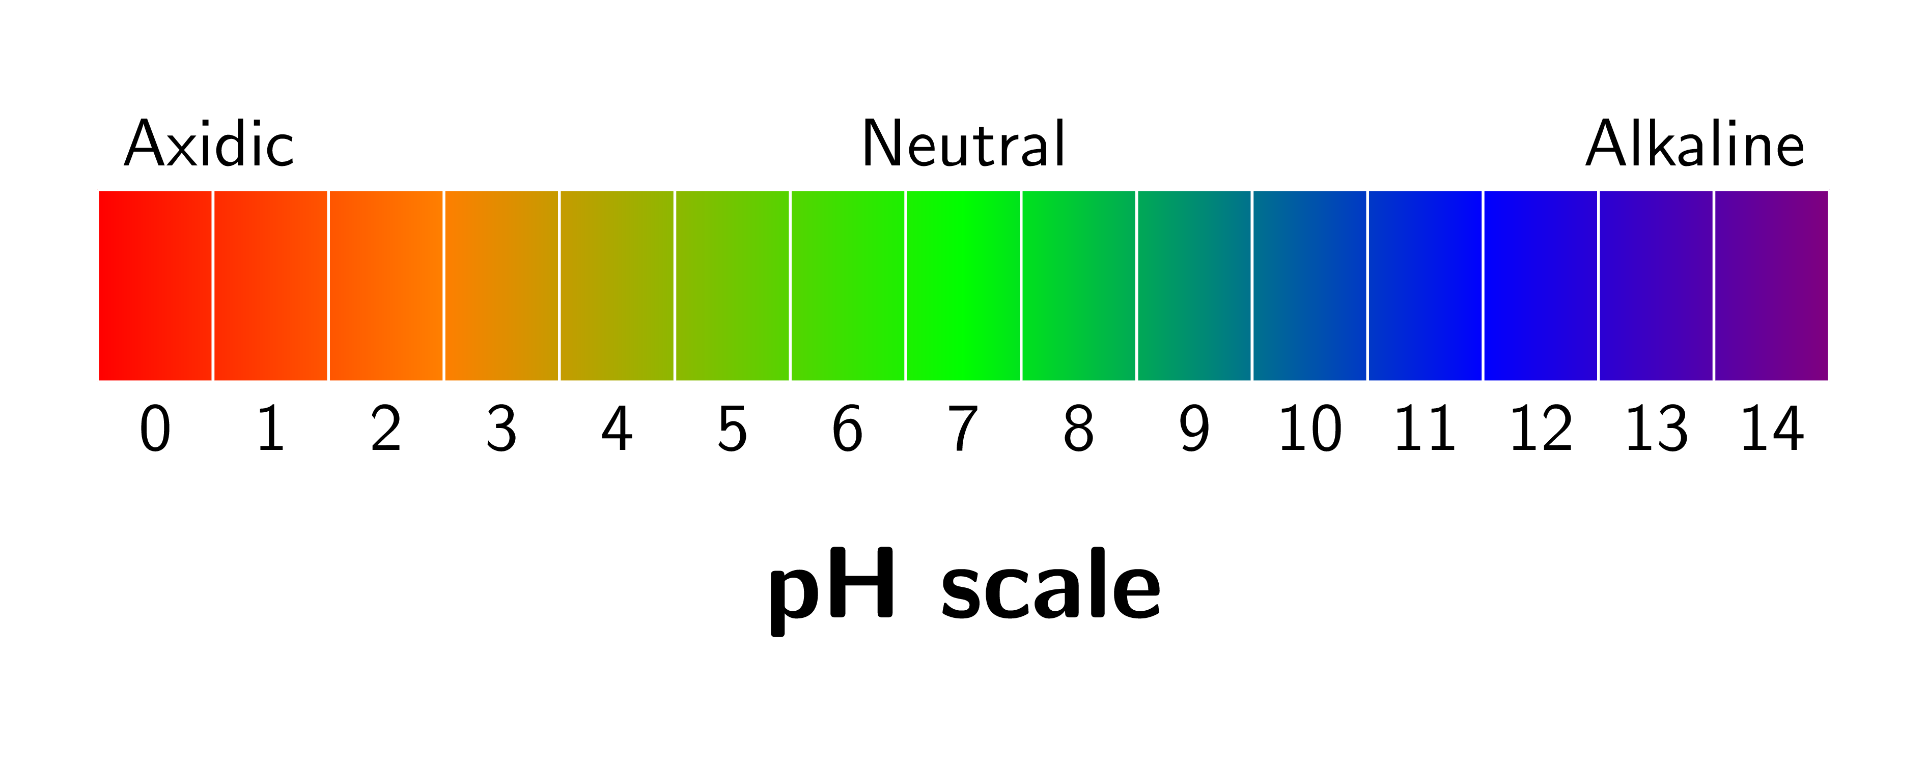
This Photo by Unknown Author is licensed under CC BY-SA

Slide 4
Acids have a pH value less than 7
Strong acids have a pH value ranging from 0-3
Weak acids have a pH value ranging from 4-6
Neutral substances have a pH value of 7
Bases have a pH value ranging from 8-14.
Weak bases have a pH value ranging from 8-10
Strong bases (Alkalines) have a pH value ranging from 11-14.

Slide 5
APPLICATION OF ACIDS BASES AND INDICATORS IN OUR DAY TO DAY LIFE.
ACIDS.
The following are uses of acids in our daily life.
Used to clean metallic surfaces.
Used in car batteries .
Used in manufacturing of paints,dyes and explosives.
Used to enhance the flavour of different foods.

Slide 6
BASES.
The following are uses of Bases in our daily life.
Used in manufacturing of Antiacids tablets.
Used in manufacturing of Fertilizers.
Used to reduce the acidity in soil. Liming of soil.
Used in manufacturing detergents.

Slide 7
INDICATORS.
The following are uses of acids – bases indicators in our daily life.
Used in:
Testing soil.
Testing water in a swimming pool.
Manufacturing products.
Testing pollution.

