Slide 1
ACIDS,BASES AND INDICATORS.
What is an acid?
What is a base?
Indicators.
An indicator is a substance that changes colour when added to a basic or an acidic solution.
There are two types of indicators:
Plant extract indicators.
Laboratory indicators.

Slide 2
Plant Extract as acid – Base indicators.
Indicators can be made at home or in classroom from parts of some plants.
We can extract acid – base indicators from coloured flowers like bougainvillea,red rose flowers and hibiscus .
Other coloured parts of plants that can be used to extract acid – base indicators include:

Slide 3
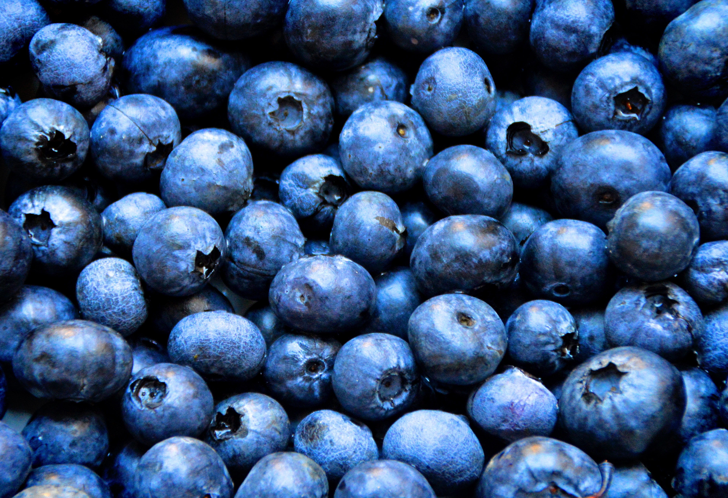
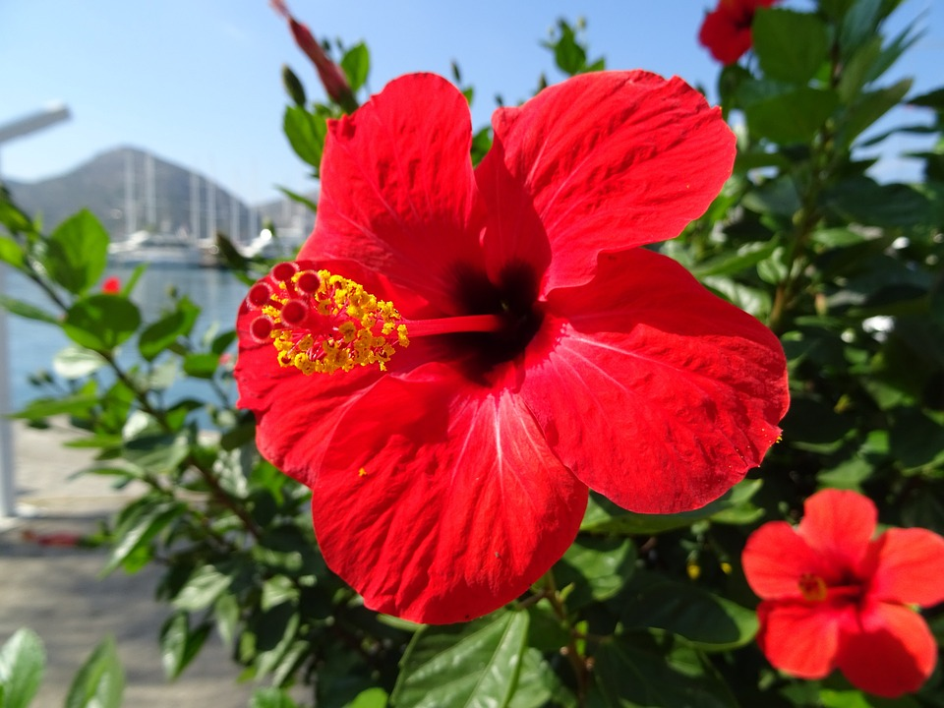
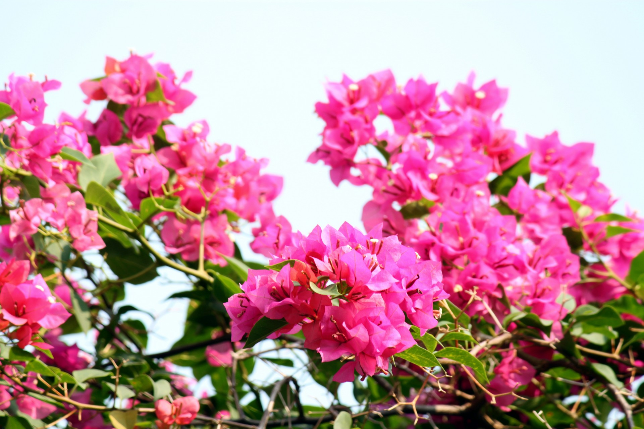
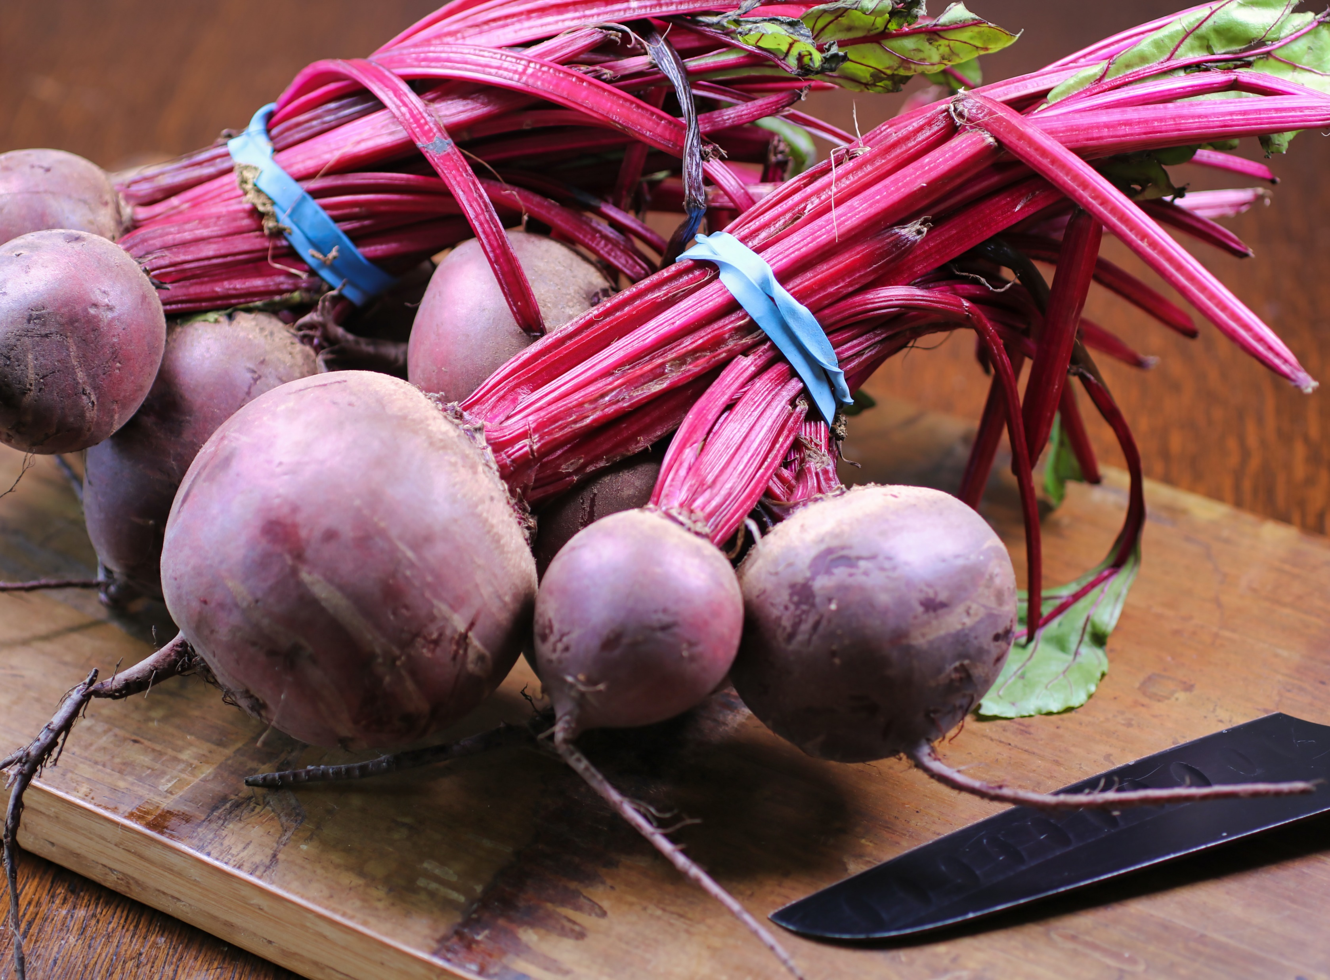
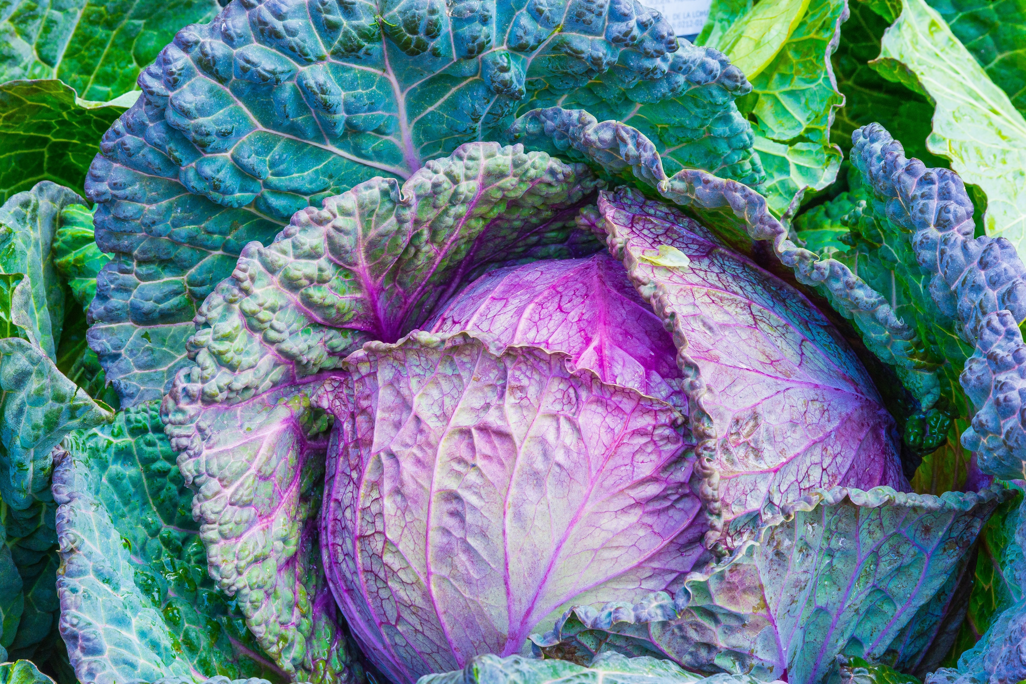
Blueberry fruits, leaves of purple cabbage and roots of beetroots.

Slide 4
How to Extract Acid – Base indicator from parts of Plants.
Cut the flower petals into small parts.
Crush the petals in a bowl or a motar.
Add propanone or ethanol drop wise to the crushed petals.
Continue crushing until you obtain a deep coloured solution.
Decant the extract into a beaker.

Slide 5
How Plant Extract indicators work.
Most Plant extract indicators give a Red,purple to Violet colour change when added to acidic solutions.
In basic solutions, plant extract indicators give a Blue,green to green-yellow colour change.
In a neutral solution plant extract indicators do not change their colour.

Slide 6
Classifying common Household substances into Basic or Acidic.
We have different solutions in our homes that are useful in our day today life.
These solutions are either Basic, Acidic or Neutral.

Slide 7
Acidic solutions include.
Lemon Juice
Orange Juice
Grape Juice
Sour milk
Vineger
NB. They change Plant extract indicator Red.

Slide 8
Basic Solutions include.
Bar soap
Wood ash
Baking powder
Toothpaste
Antiacid tablets
NB. They turn plants extract indicator Blue/green in colour.

Slide 9
Neutral Solutions include.
Sugar
Salt
Water
NB. They do not change the colour of plant extract indicator.

